Slide 1
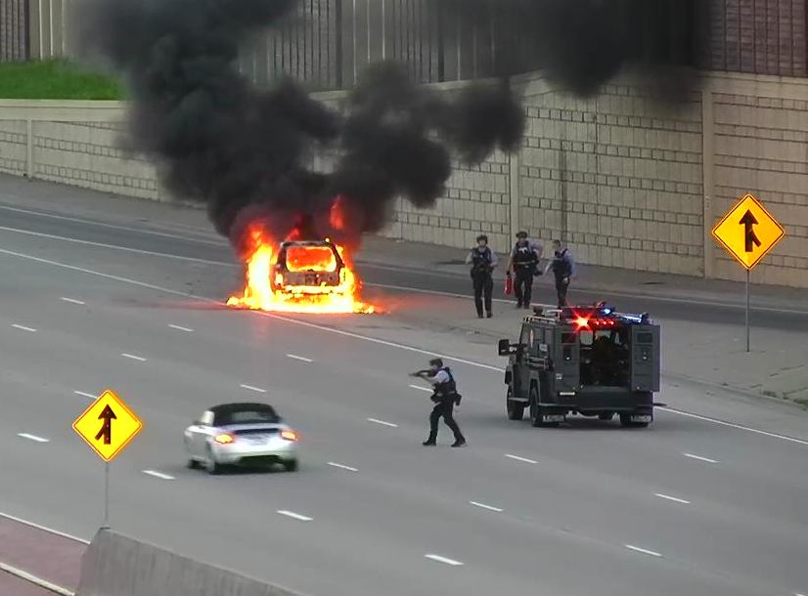
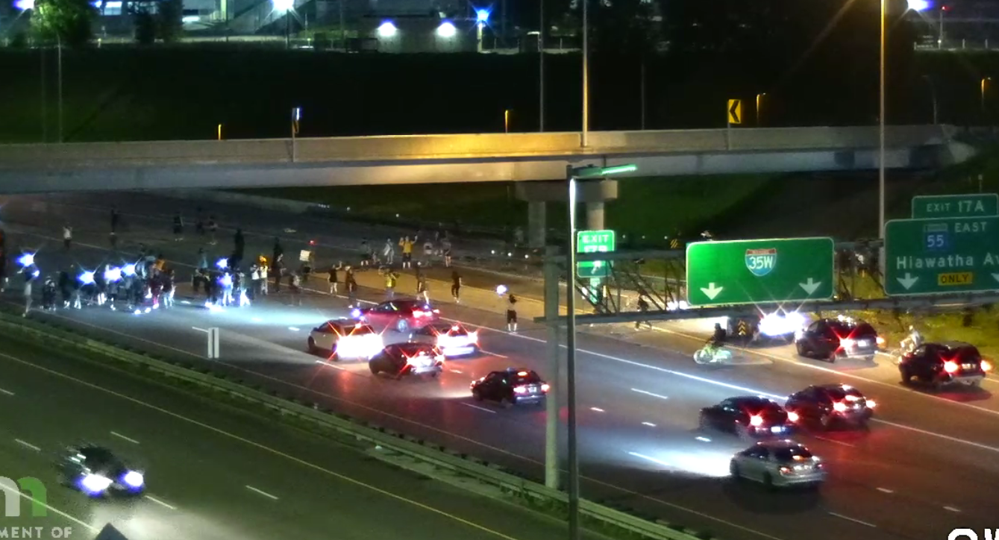
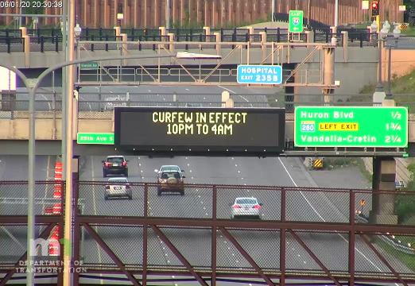
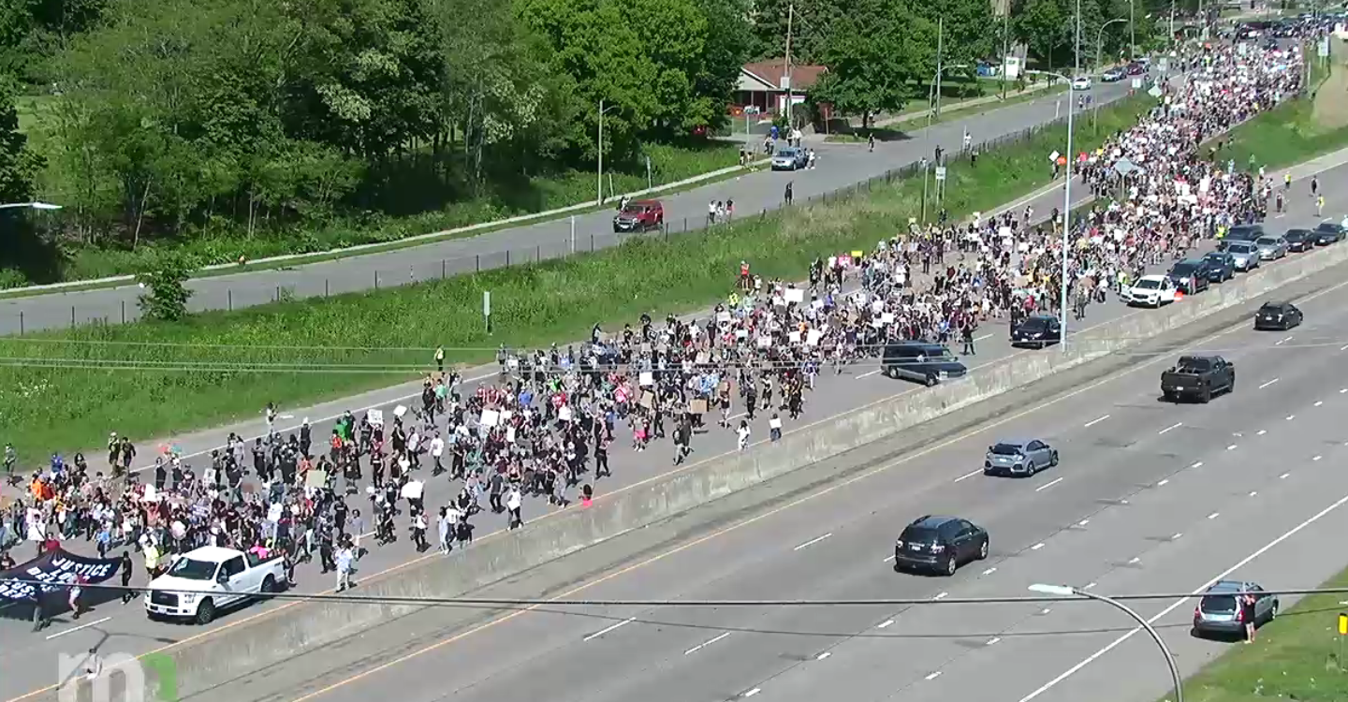
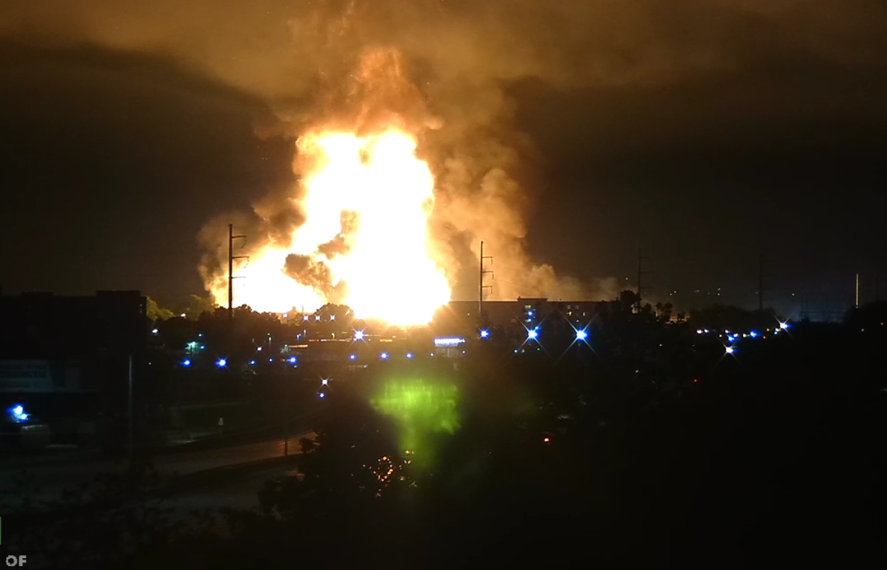

Major civil disturbances impacting freeways
Safety Service Patrol Idea Sharing Network

Slide 2
George Floyd 5/25/20 - the specifics
The murder itself
Witnesses with cameras / instant share
Mpls/MN history
COVID
Lessons learned when it all goes off the rails.
Safety Service Patrol Idea Sharing Network
Notes:
Clark – I 94 march. MOA, Airport closure
Castille – Some 94. Lots of Snelling. Violence on after acquittal. On 94 St P

Slide 3
MN experience
RNC 2008
Jamar Clark 2015
Philandro Castile 2016
George Floyd 2020
Safety Service Patrol Idea Sharing Network
Notes:
Clark – I 94 march. MOA, Airport closure
Castille – Some 94. Lots of Snelling. Violence on after acquittal. On 94 St P

Slide 4
#1 Honest discussion with LE
What is plan if NO LE?
Be clear on expectations for assistance by law enforcement.
Traffic control. Secondaries. General incidents.
Safety Service Patrol Idea Sharing Network

Slide 5
#2 Preplanning, staging, deployment
TRUST - inclusion on discussions during pre-planning – likelihood of incidents, issues, targets, intel.
You may need to do your own research
No staging on freeways (LE & DOT). Lights off.
Who makes call to shut down? On what trigger?
Who to contact if issues/questions?
ICS form!!
Safety Service Patrol Idea Sharing Network

Slide 6
#3 TMC Dispatch sharing info with FSP
“I just exited freeway to turn around and ran in to a group of 50, some carrying AK-47s” - FSP
TMC notify FSP ahead of time of potential issues
Notify FSP as possible of group locations
Safety Service Patrol Idea Sharing Network

Slide 7
#4 Hot / warm / cold zones for FSP
Cold – no reasonable expectations to encounter protest groups
Warm – reasonable potential, but reasonable amount of time to warn, leave cones, and evacuate the area *
Hot – Too close to allow time to evacuate – potential to be over run **
* Variable -- Walkers? Running? Bikers? Motorcycles?
** Smart evaluation of the group & risk levels.
Safety Service Patrol Idea Sharing Network

Slide 8
#5 Main lines vs. ramps
Who’s closing the ramps?
Difficulties in predicting crowd movements!
Hard closures & soft closures.
Full closure just before scene
Closure at logical freeway-to-freeway jct
Ramps in between left open – as resources allow
Safety Service Patrol Idea Sharing Network

Slide 9
#6 Closure barriers types
No type-3’s in hot/warm zone
Cones useless
Barrels - better but can be repurposed
Triton barriers pre-staged in hot & warm zones. Empty. Crews with water trucks to deploy if needed.
Ramp Gates?
Safety Service Patrol Idea Sharing Network

Slide 10
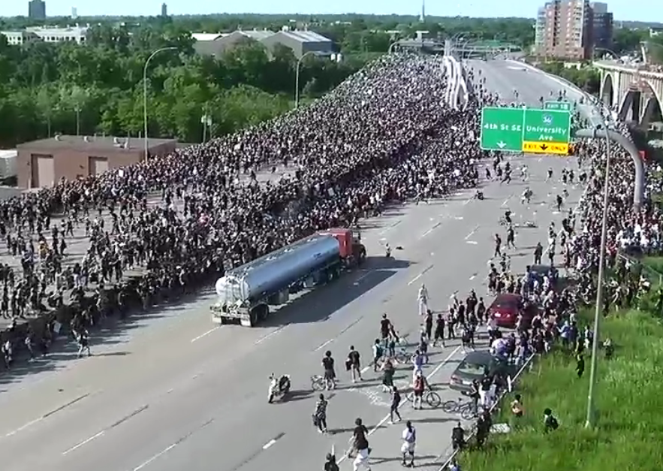
What if?
Safety Service Patrol Idea Sharing Network

