Slide 1

SafeHighways.org / Idea Sharing Network Webinar Series
Session 23: Major Events and Congestion Management
March 10th 2022
Notes:
Target time – 50 mins.

Slide 2
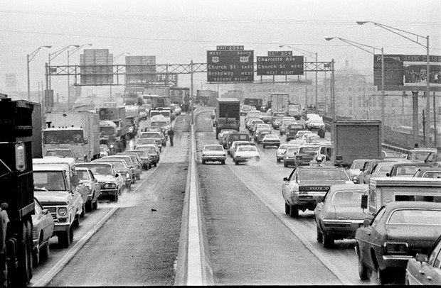
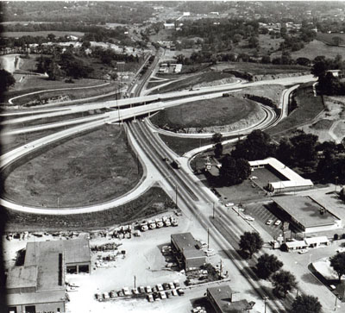
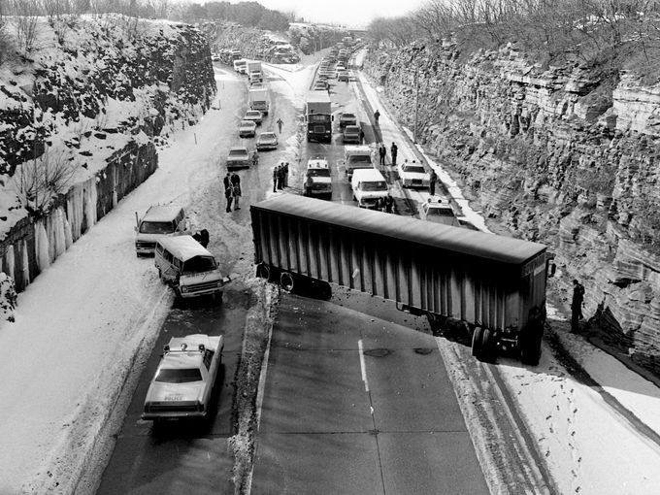
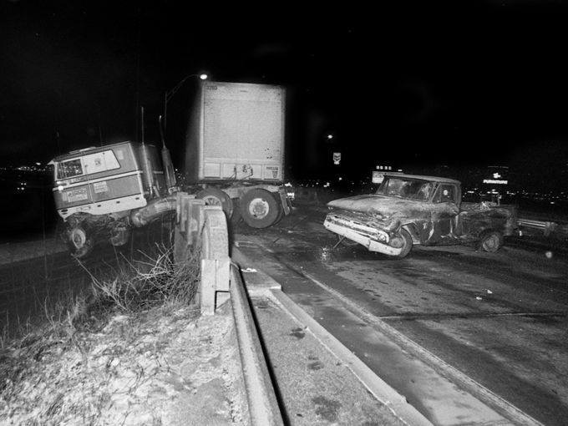
The way it used to be...

Slide 3
Where we Were... (Pre-2012):
Weather Events (Snow & Ice, Flooding, Storm Events)
Slides
Sinkholes
Set Up Traffic Control for Traffic Incidents
Traffic Incident Management Urban Area
  HELP Program 1999
  TMC 2003
  7 day coverage (urban) 2004
  Rural I.T.S. expansion 2006

Slide 4

…and along comes 40,000 lbs. of potatoes...

Slide 5
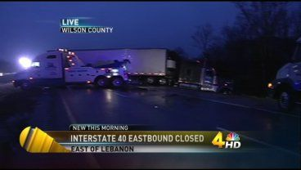
12 + Hours...

Slide 6
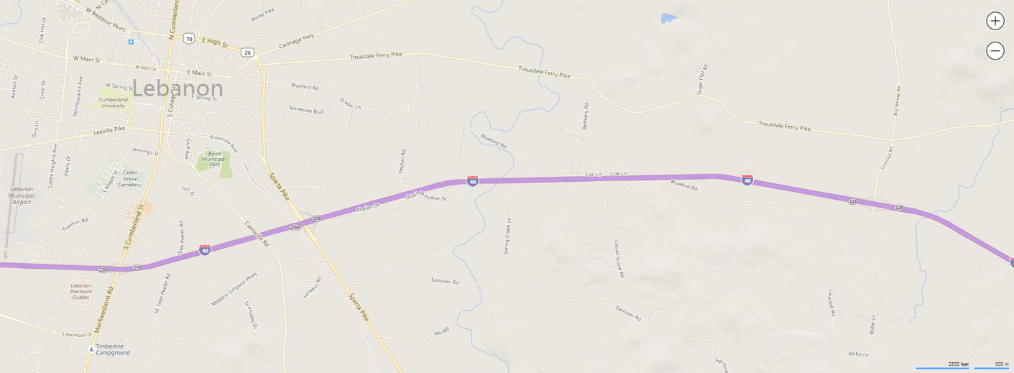
Exit 245
MM 244
STUCK TRAFFIC
Exit 239
Detour Traffic

Slide 7
Hundreds of motorists stuck for 12+ hours
Included a school bus full of children from Cookeville
NO food, medicine, or restrooms
NO well-being/welfare checks
NO effort to re-direct traffic caught in closure
NO effort to expedite clearing of roadway

Slide 8
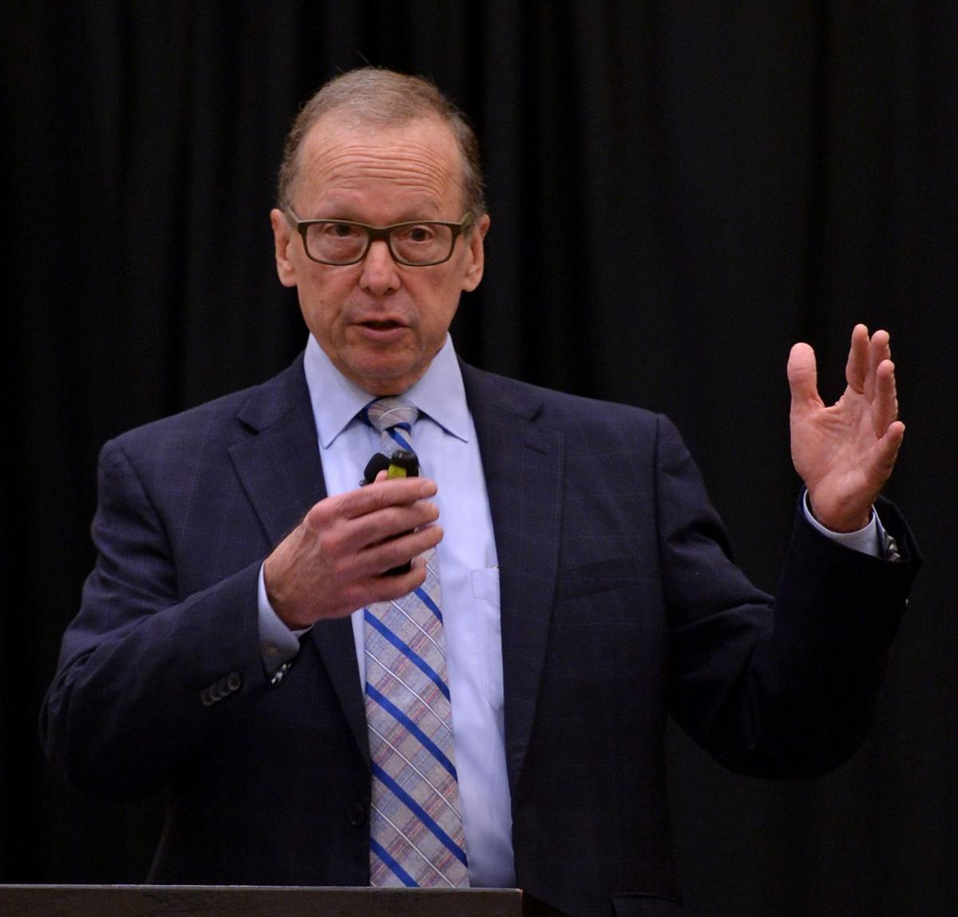
NOT HAPPY...
TDOT COMMISSIONER 2012
John Schroer

Slide 9

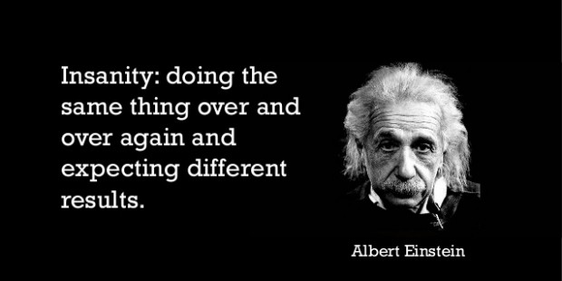
Wise men say...

Slide 10


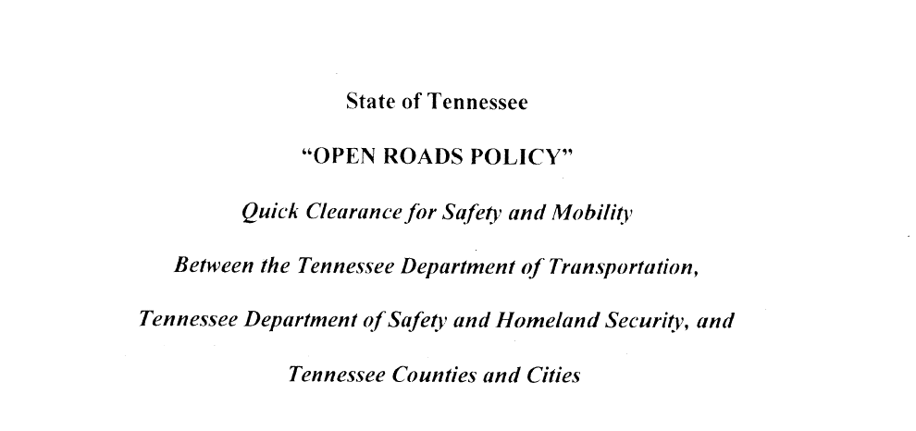

Slide 11
Conduct investigations in expedient manner
Coordinate w/TDOT for detours & safe movement of stuck traffic
Ensure Tow Operators are trained & have appropriate equipment
Will not cause reopening delay to allow trucking company to dispatch own equipment to off load/recover cargo if creating hazard or impacting traffic.

Slide 12
Shall respond and deploy resources/personnel to MAJOR incidents 24/7
Provide initial traffic control within 30 minutes during working hours or 60 minutes after hours/weekends
Deploy whatever equipment needed to reopen roadway
Continue to work with THP to ensure motorists needs are being met in the most SAFE, professional and efficient manner possible

Slide 13
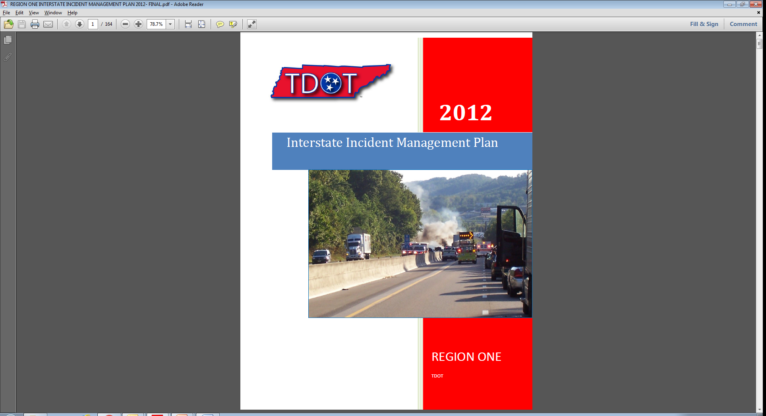
Pre-Established DETOURS
Plans are updated annually for each Region Operation.

Slide 14
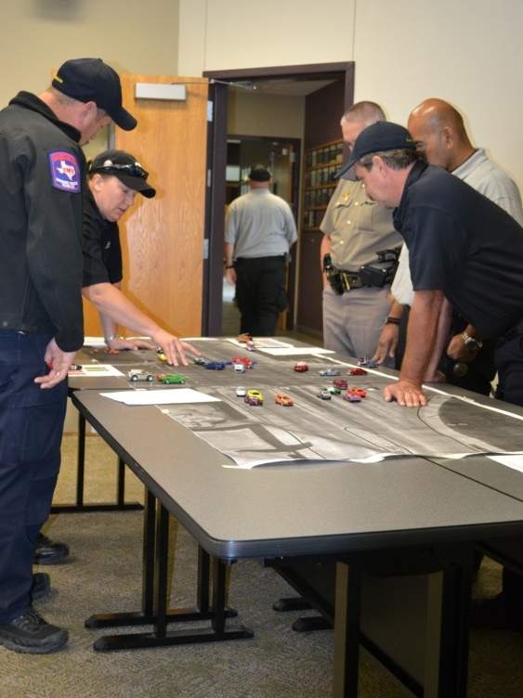
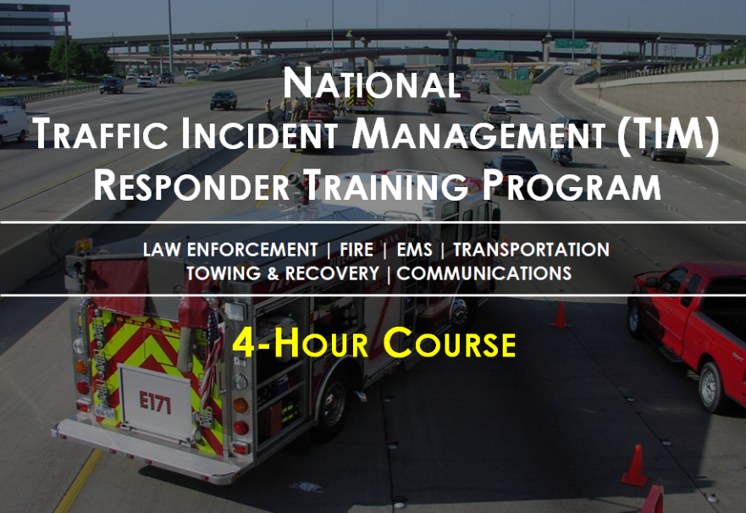
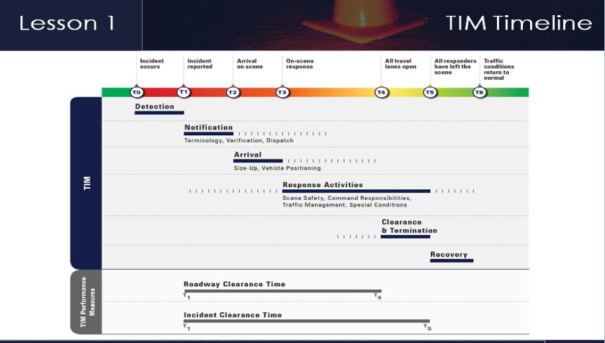
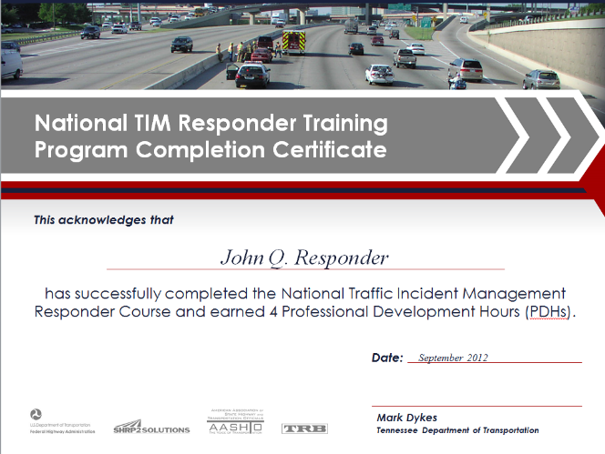
USDOT and FHWA began foundations in 2010 and instituted TIMS nationally in 2012. In 2022 there are over 560,000 trained.

Slide 15
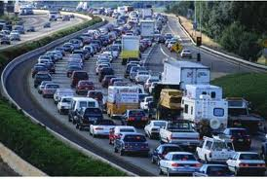
Where we are now.
Let's take a look...

Slide 16
TIMs = TEAMWORK
“Teamwork makes the 'Dream' work.”
for ALL Incident types...
Major, Intermediate, and Minor.

Slide 17
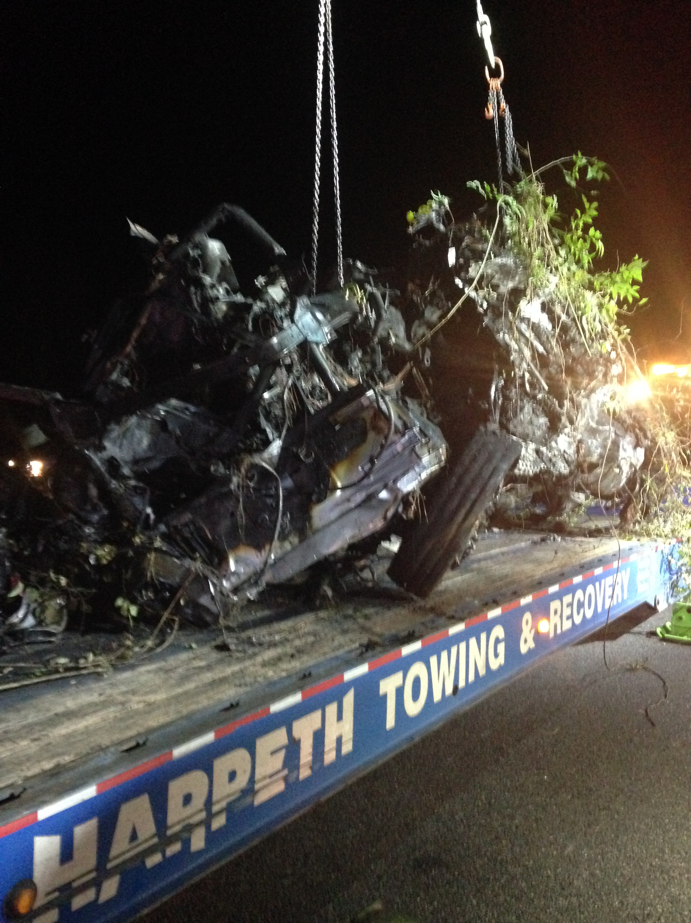
Crossover MVA involving CMV and SUV
5:00 PM Rural Interstate with overwhelmed alternate rural routes.
5/2018 I-65 SB MM 53 / 17:00 hours MAJOR EVENT
Fatality
CMV on FIRE.
Immediate secondary crash w/2 Critical injuries.
LifeFlight on scene.
8 Agencies involved.
ALL SB and all NB lanes blocked initially for one hour.
Contra-Flow Lanes established allowing one lane NB and SB on the NB side for 3 hours through Cooperative effort by ALL agencies.
Investigation and recovery done concurrently.
Detection time to completion: 5 hours.

Slide 18
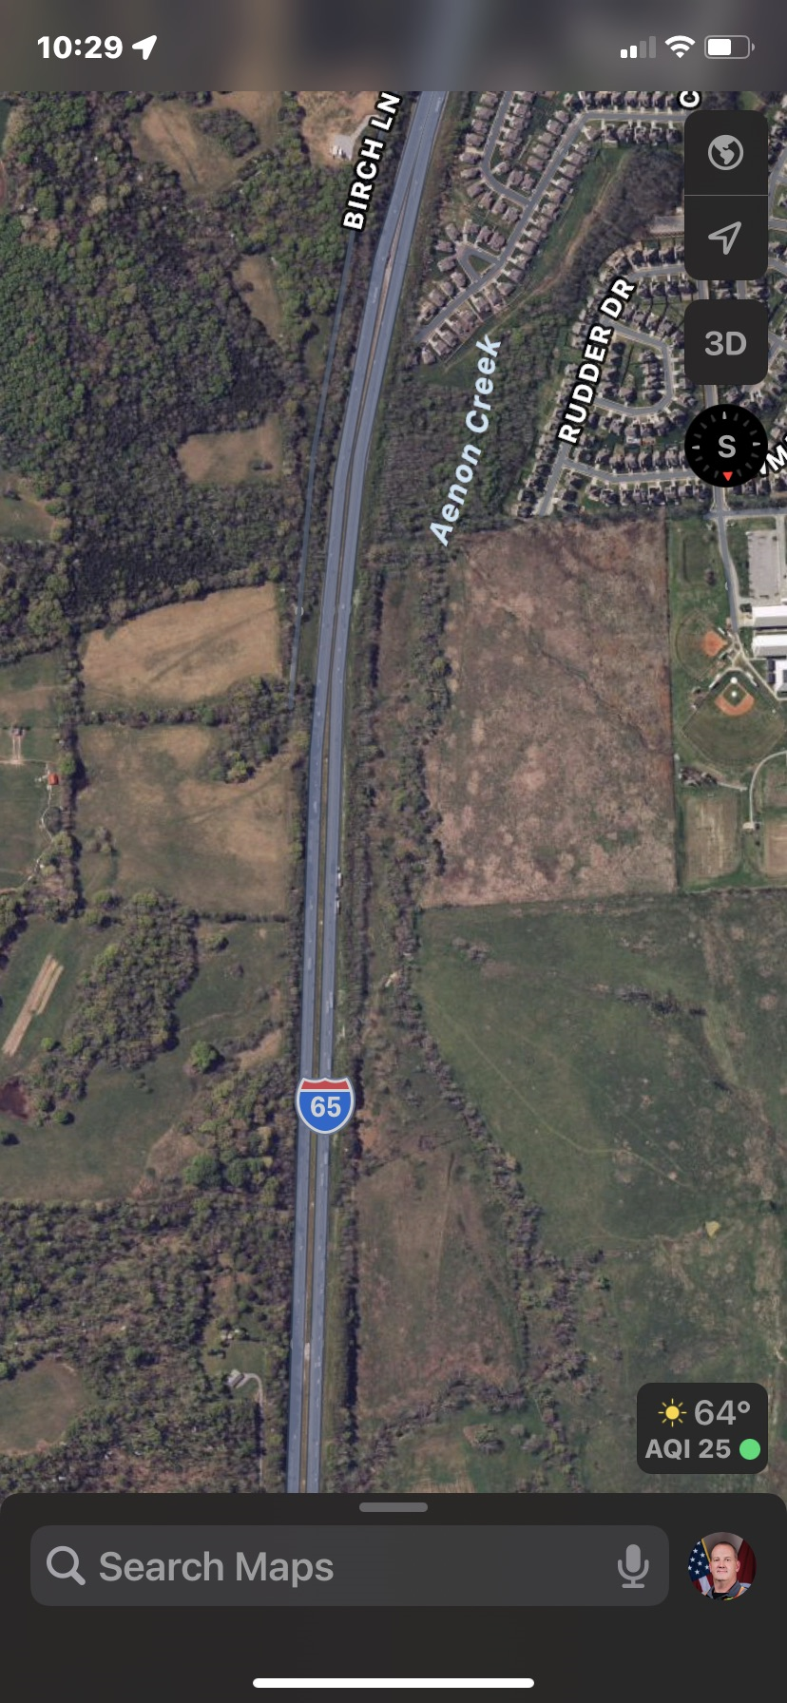
Alternate Routes were quickly Overwhelmed...
Initial crash involved a vehicle which crossed the median after leaving NB lanes.
A secondary crash occurred in the NB lanes within minutes of the initial crash.
Firefighting efforts required the use of both lanes SB initially due to no water supply.
ALL lanes closed in order to establish LZ for LifeFlight Helicopter for Critical patient.
Investigation would require at least the left lane NB, and both lanes SB for investigation, mapping, etc.
CMV Vehicle Recovery would require at least the right lane SB to recover vehicles.
Daylight giving way to darkness another big consideration.
Traffic queue on SB side six miles long... NB queue was up to four miles long.

Slide 19
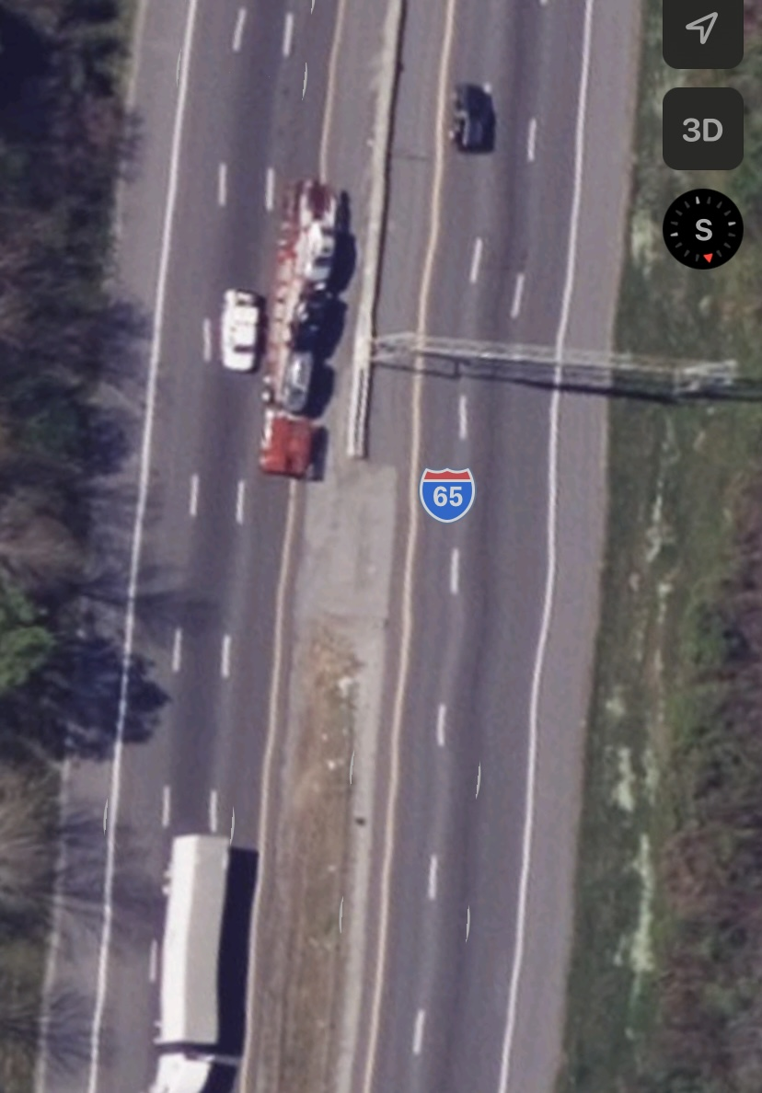
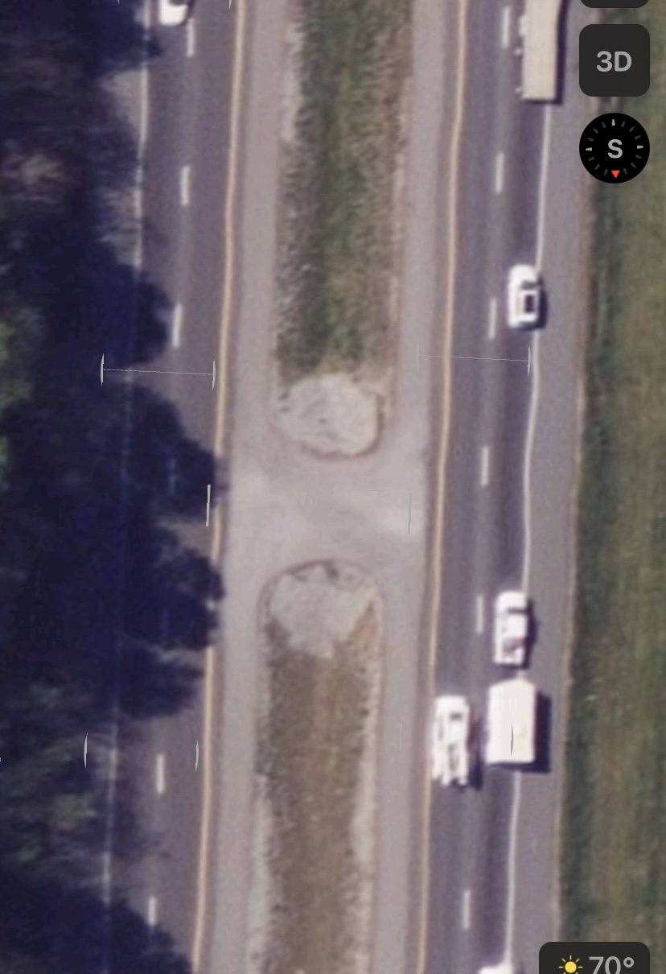
Recommendation made: Use Contra-Flow Lanes
Planning took 30 min. to coordinate
Contra-Flow traffic patterns are Non-Typical in nature.
Initial coordination by Incident Command (Unified Command) sought recommendations... The incident location had two paved median crossovers about one mile apart that would serve this purpose very well.

Slide 20
Coordination, Cooperation, Communication...
Unified command (THP) accepted the recommendation from TDOT HELP Supervisor on scene to establish Contra-Flow lanes on the NB side in order to flow traffic in both directions to alleviate the trapped traffic on both sides and give full room to expedite the CMV & fatality vehicle/victim recovery and removal. This would also allow more room to focus on investigation/mapping efforts.
Detour/Diversions were left in place until after traffic flow was established.
Once plan was established and communicated to TMC, TDOT HQ expressed reservations about using Contra-Flow lanes. Coversations directly between THP Colonel on scene and TDOT HQ were instrumental in gaining approval to establish Contra-Flow style traffic control.
Traffic Control plan, objectives, and tactics were discussed with ALL agencies involved. ALL agencies agreed and plan was carried out operationally with ALL agencies playing a part, and full communication between agencies established.
One lane traffic flowed in each direction for almost three hours. During this time all of the other activities were carried out; At the conclusion of the event traffic control elements were demobilized, and all lanes NB were restored. The SB right lane remained blocked for an additional thirty minutes to load equipment; There was no traffic queue in either direction at that time.

Slide 21

In June of 2013, the Protect the Queue campaign was born.
TDOT's Protect the Queue campaign, data gathered from July 2013 through December 2013 showed a 19% reduction in secondary incidents over the same period in 2012.
Studies prove the likelihood of a secondary crash increases by 2.8 percent for each minute the primary incident continues to be a hazard.
As much as 25% of all traffic incidents are secondary crashes, and up to 20% of those involve serious injuries or fatalities.

Slide 22
Where We Want to Go...
Continue to improve SAFELY.
Keep all responders SAFE utilizing best practices.
Keep the motoring public SAFE by reducing secondary crashes, improving the travel environemnt.
Embrace and utilize emerging technologies to improve safety and development. ( HAAS Alerts )
Train even more responders in TIMS.
Maintain and build upon the great partnerships developed with all partners.
New Traffic Control Devices/Equipment.
Identify potential safety improvement areas.

Slide 23
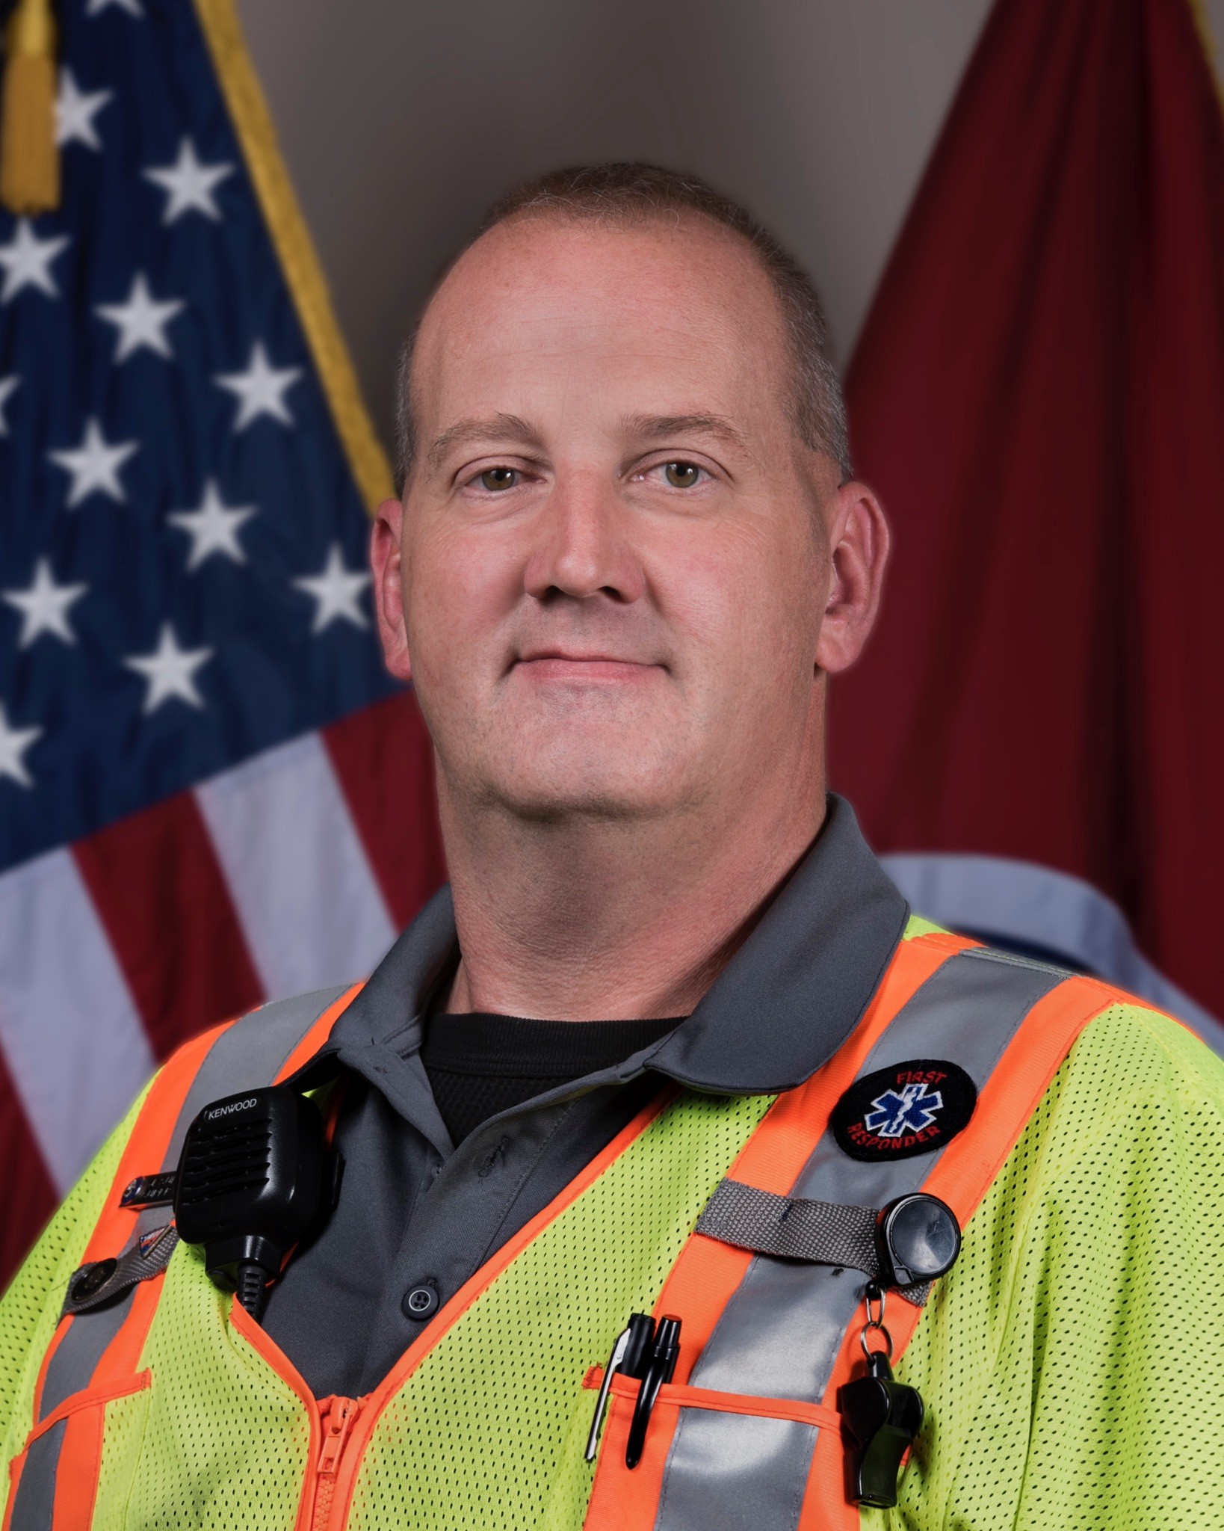
John M. Sullivan
Highway Response Supervisor I
TDOT ‘HELP’ Region III Nashville
615-349-5298
615-476-8850 john.m.sullivan@tn.gov
Questions?

