Slide 1
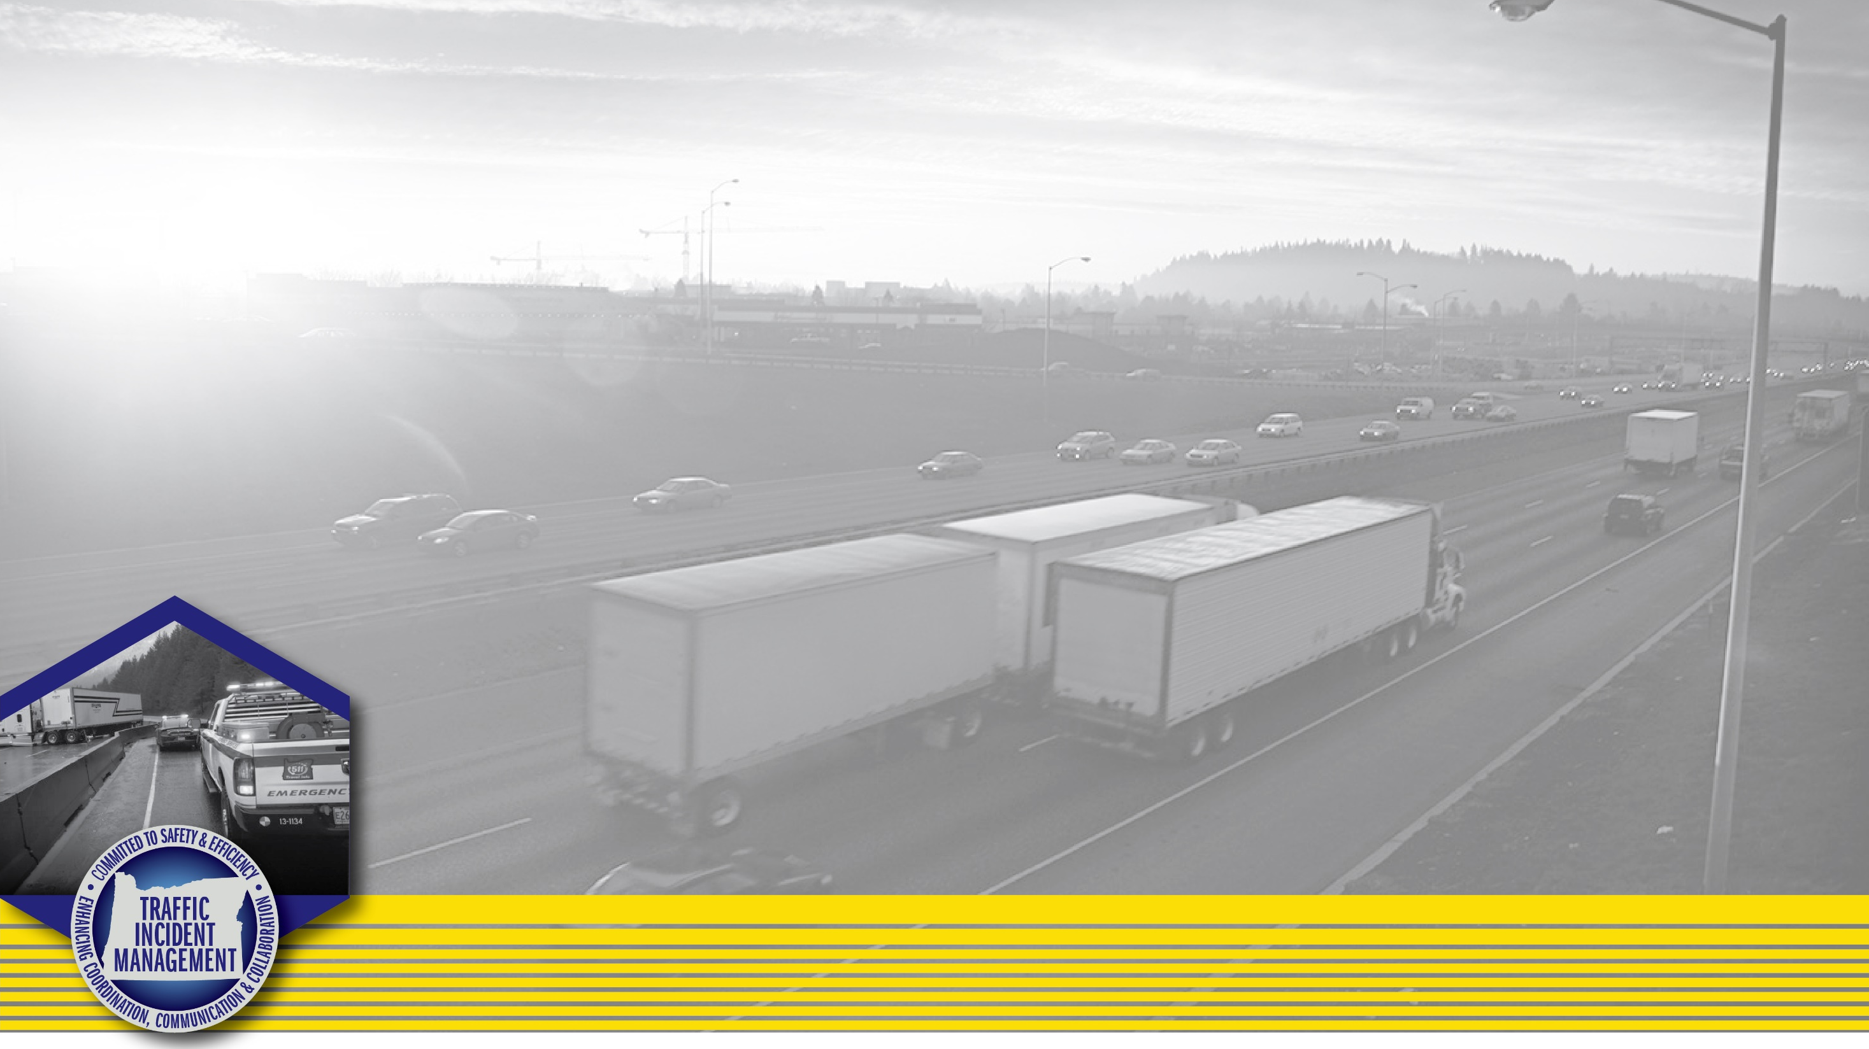
Oregon I-84 Closure

Slide 2
The Situation
Presidents day, Noon
Minimum staffing
Weather that wasn’t predicted
Employees do not live locally, no on site housing

Slide 3
ODOT Region 5

Slide 4
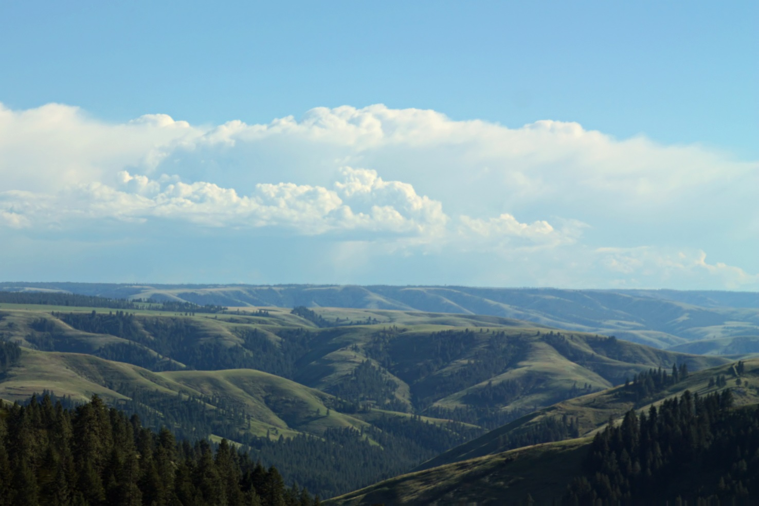
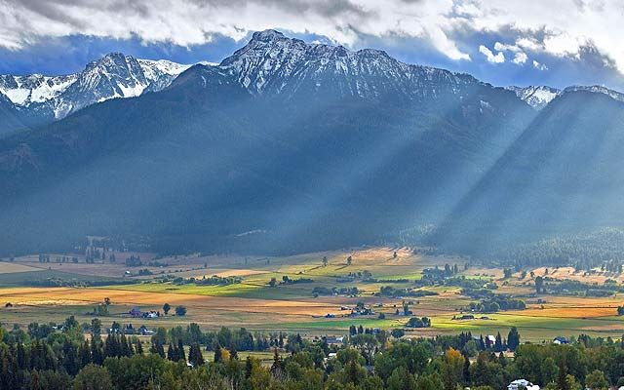
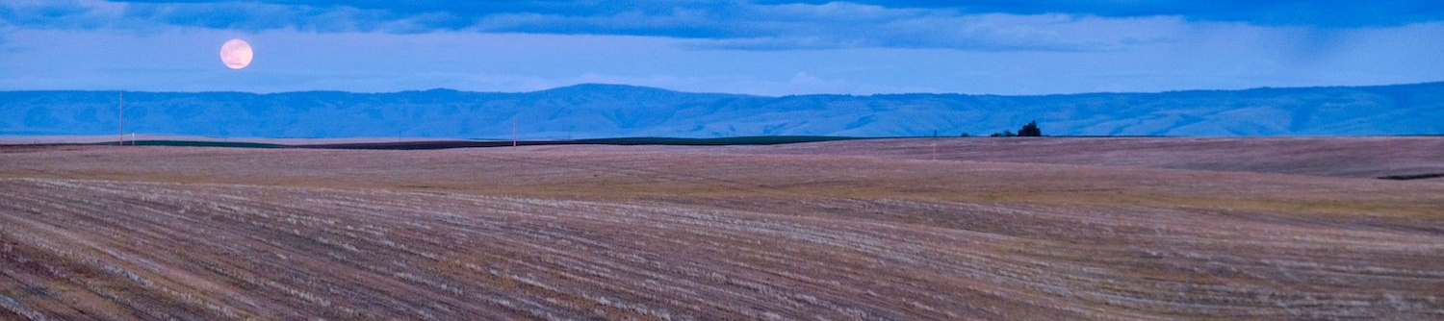

Slide 5
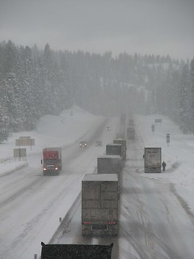
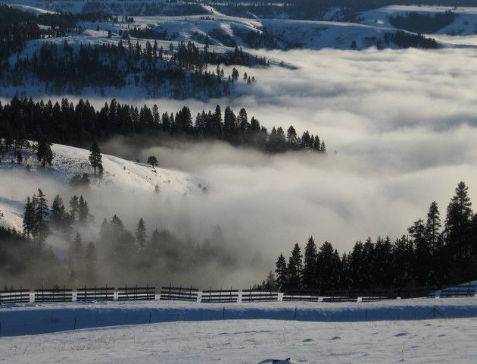

Slide 6
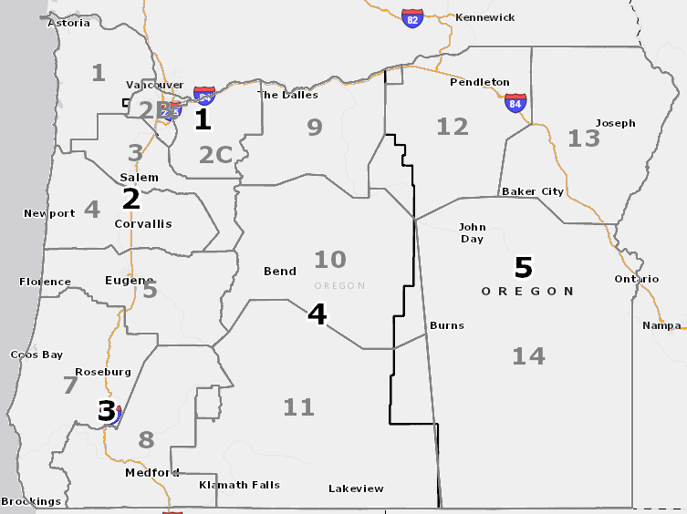

Slide 7
I-84 Meacham Incident

Slide 8
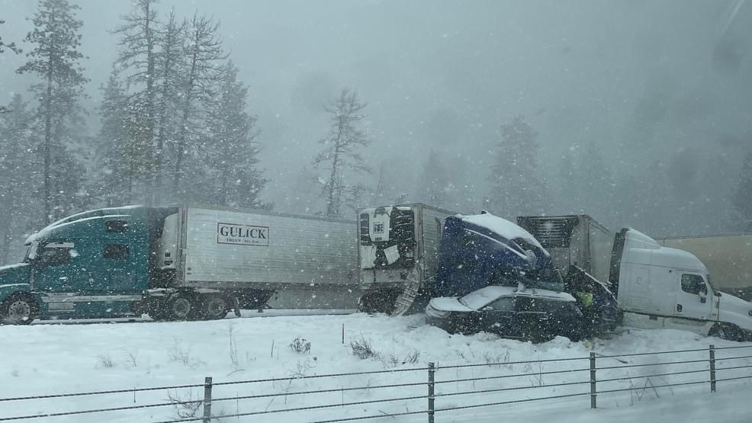
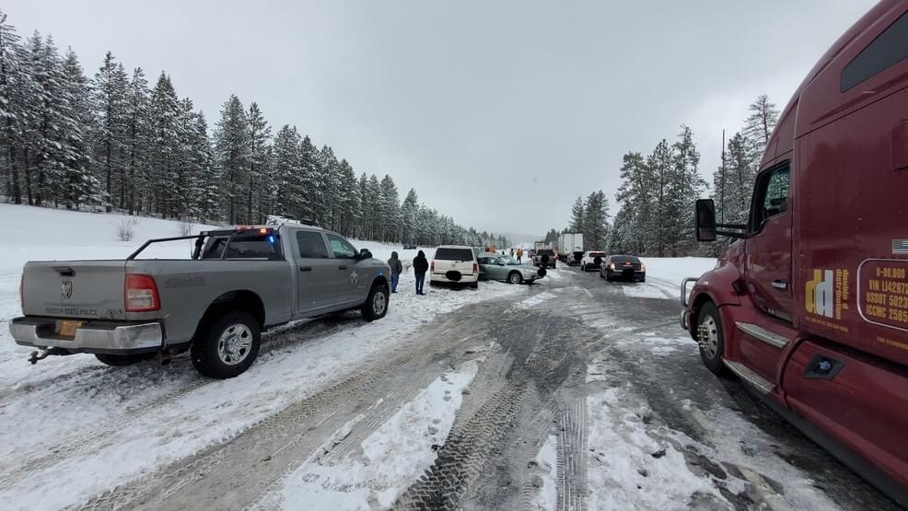
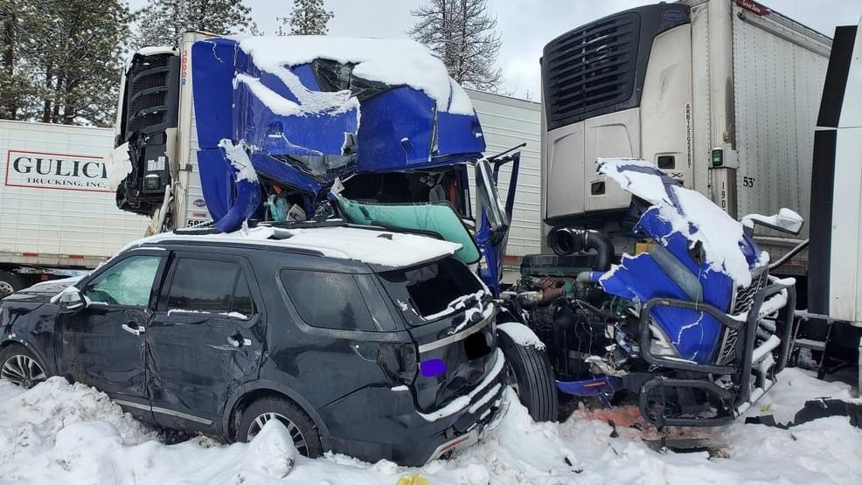
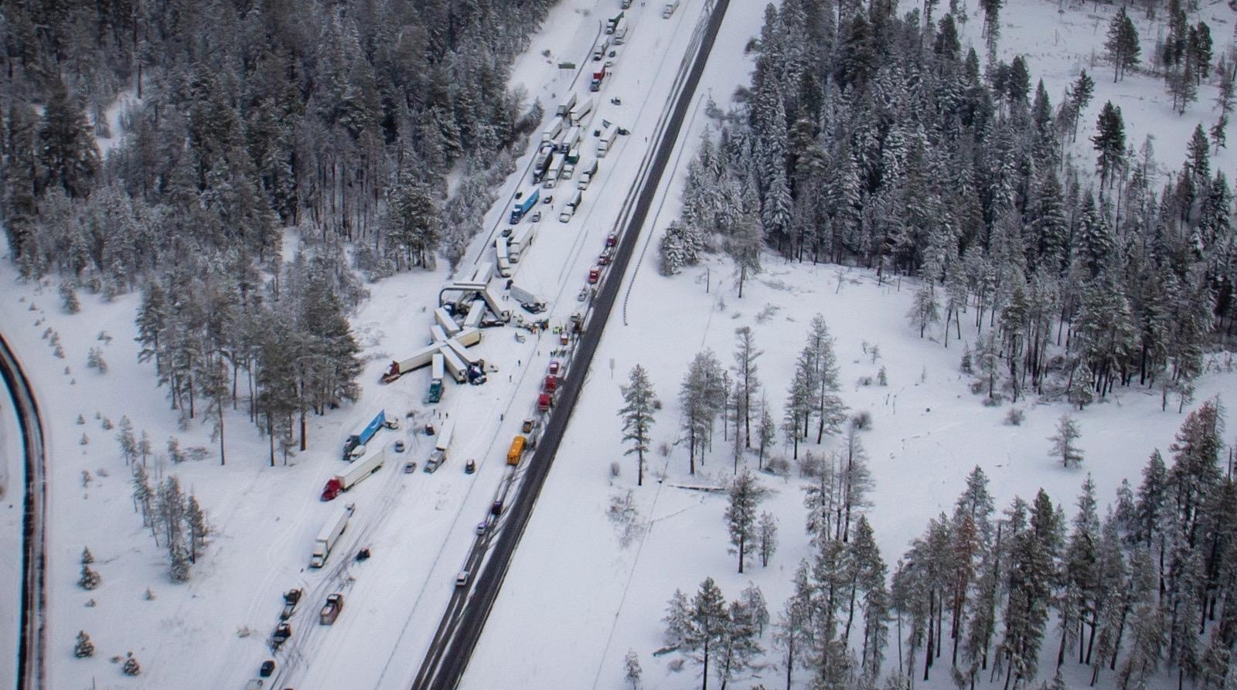

Slide 9
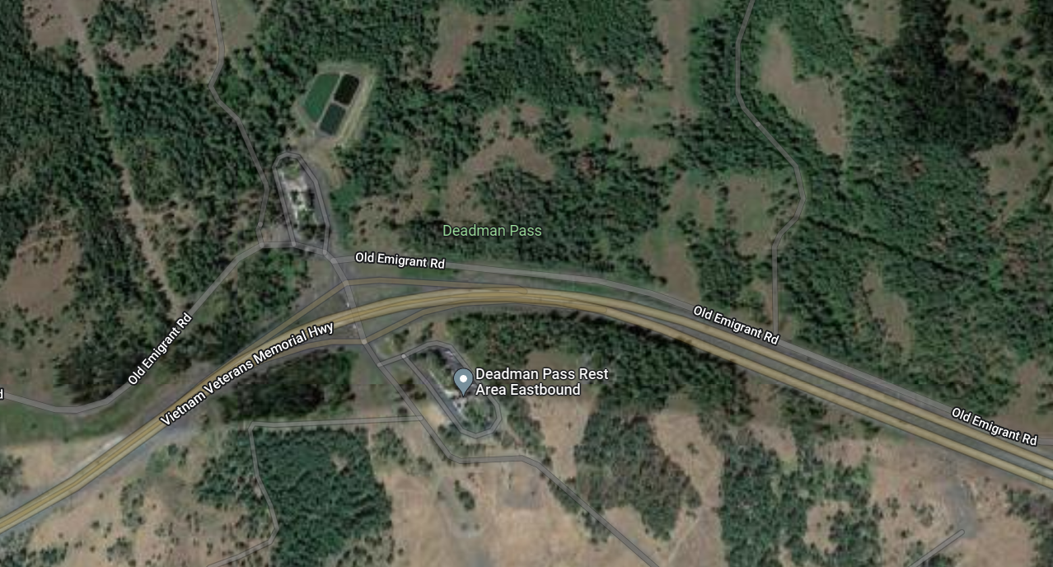
Rest Areas were used to stage tows and other equipment. This was to prevent equipment from flooding the scene.

Slide 10
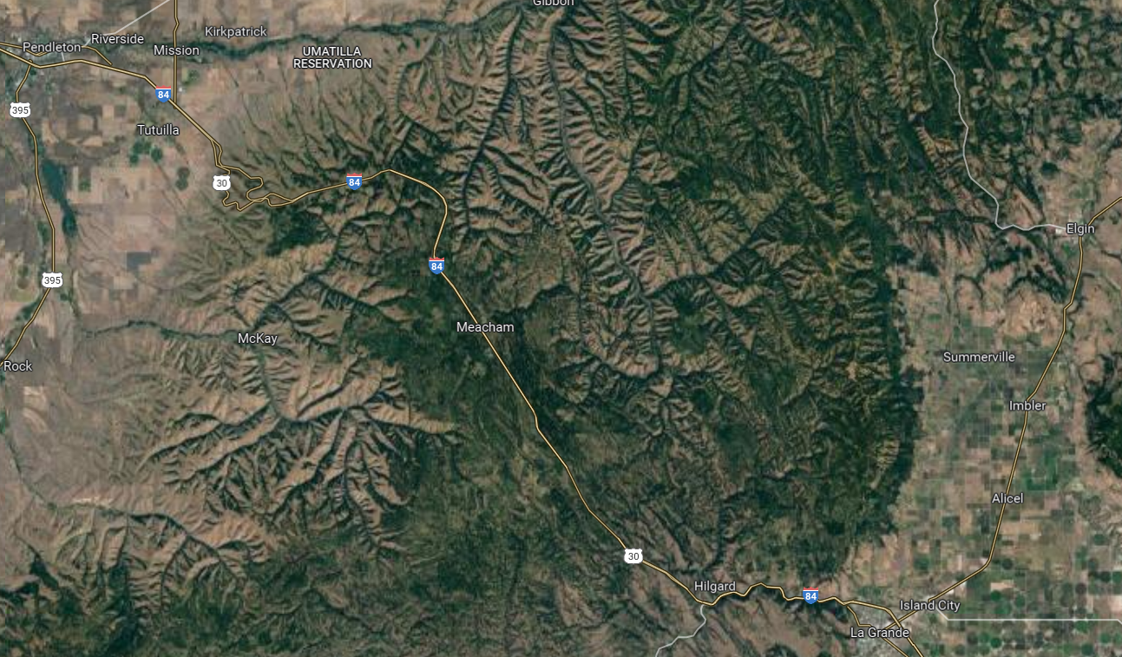

Slide 11
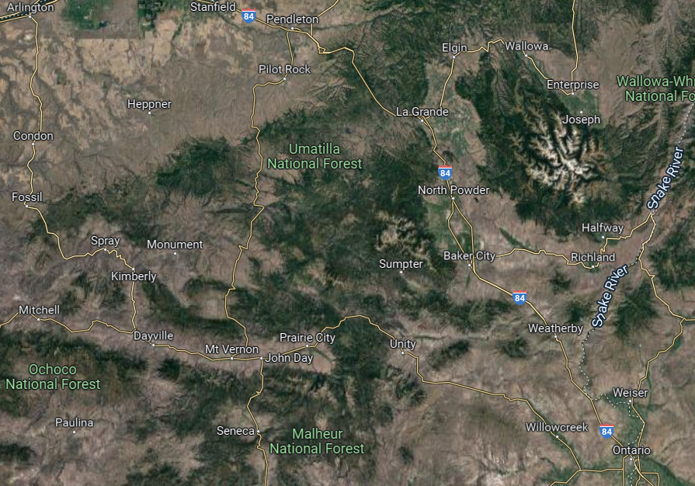

Slide 12
Summary
Total of 170 vehicles
Over 5 tow companies needed
Ambulances form all over the are
17 transported, all minor
70 moved by bus to relocation site

