Slide 1
Crash involving spill
eastbound i-94 at metro parkway
December 3, 2021, 06:40 am to 05:24 pm
Additional clean up required on December 4, 2021

Slide 2
Timeline review
Notes: Additional clean up was required on 12/4/2021 11:44 AM – 02:42 PM North River Rd, Joy Rd Overpass and Crocker Rd

Slide 3
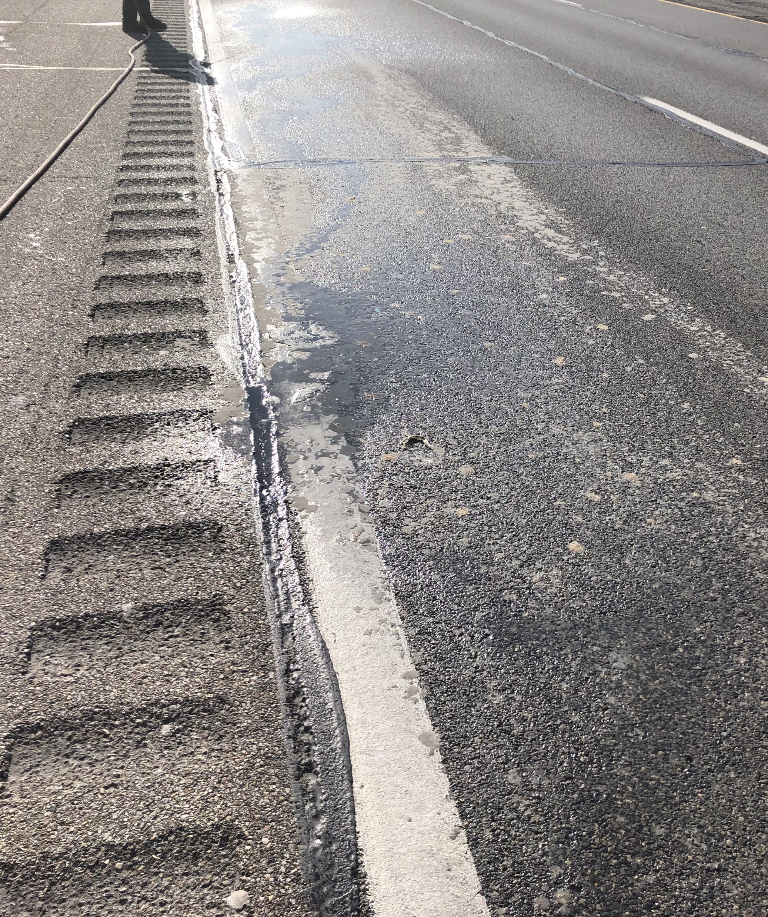
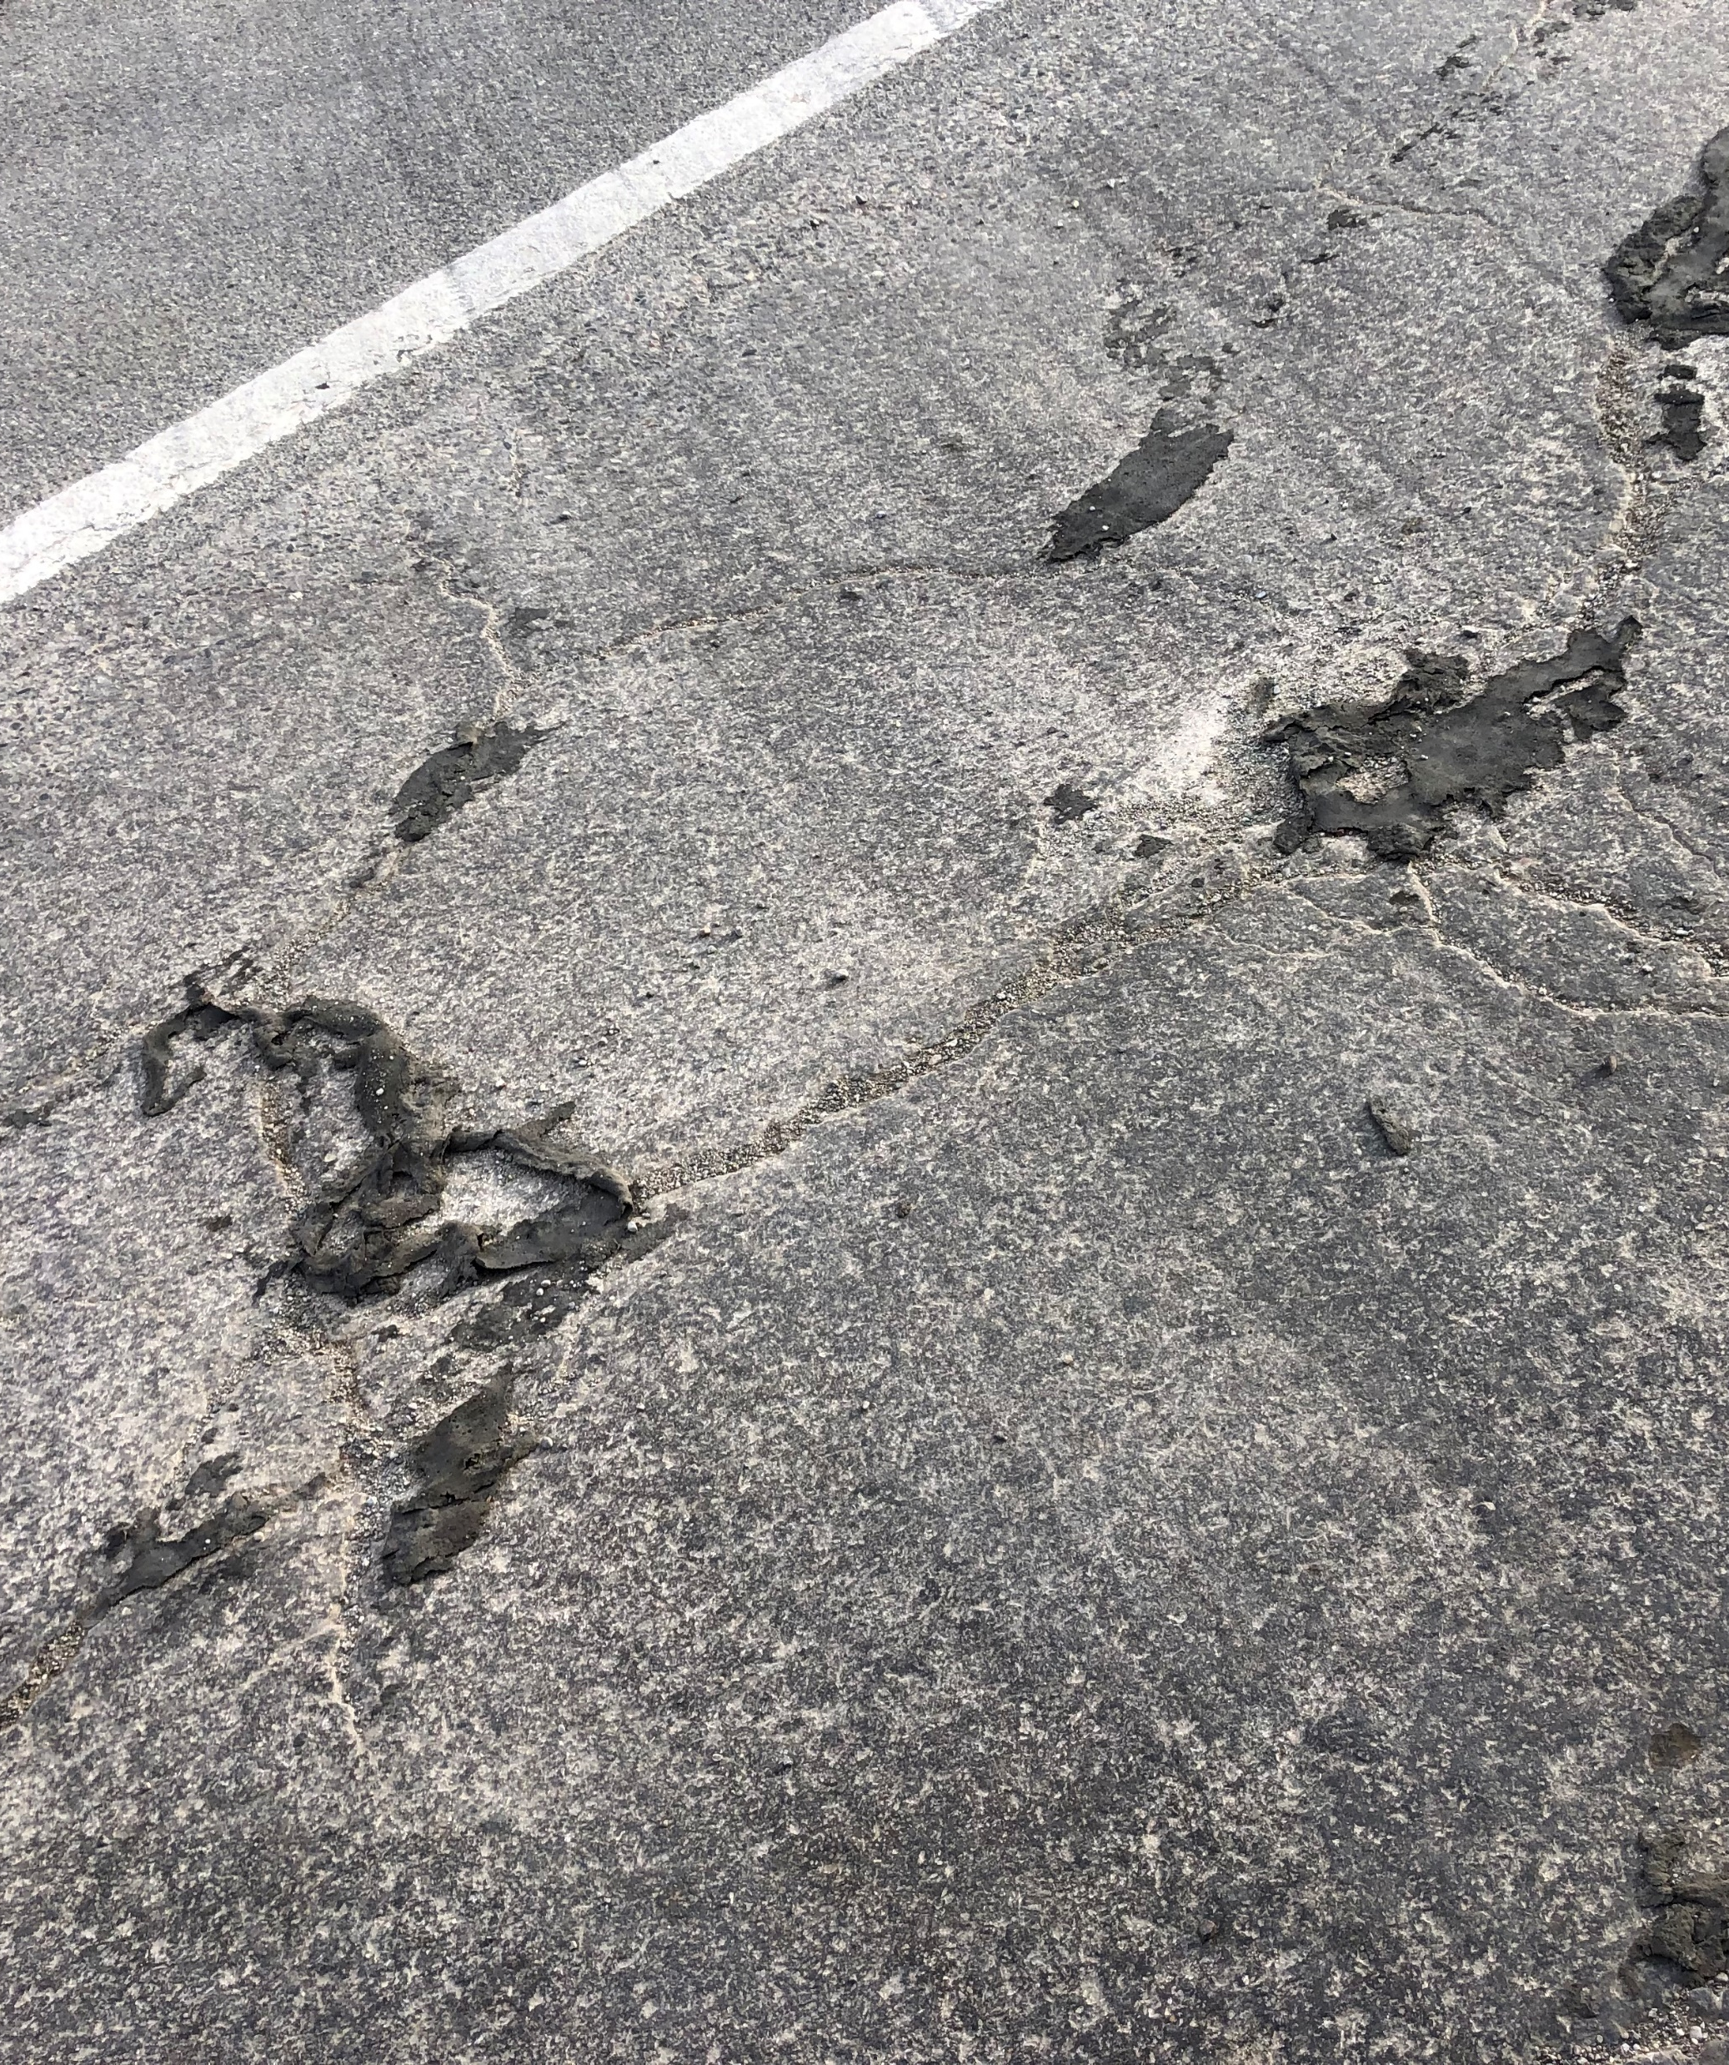
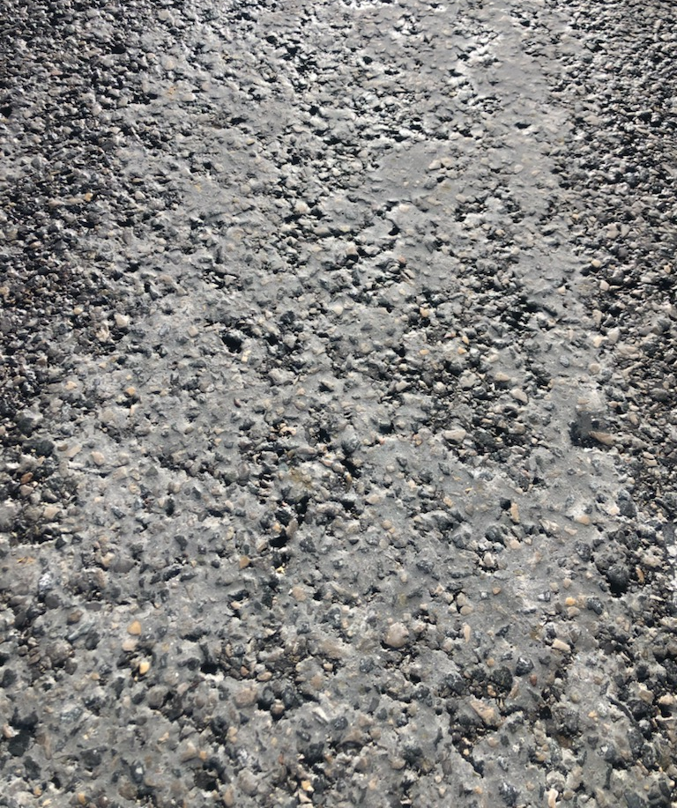
Photos from scene

Slide 4
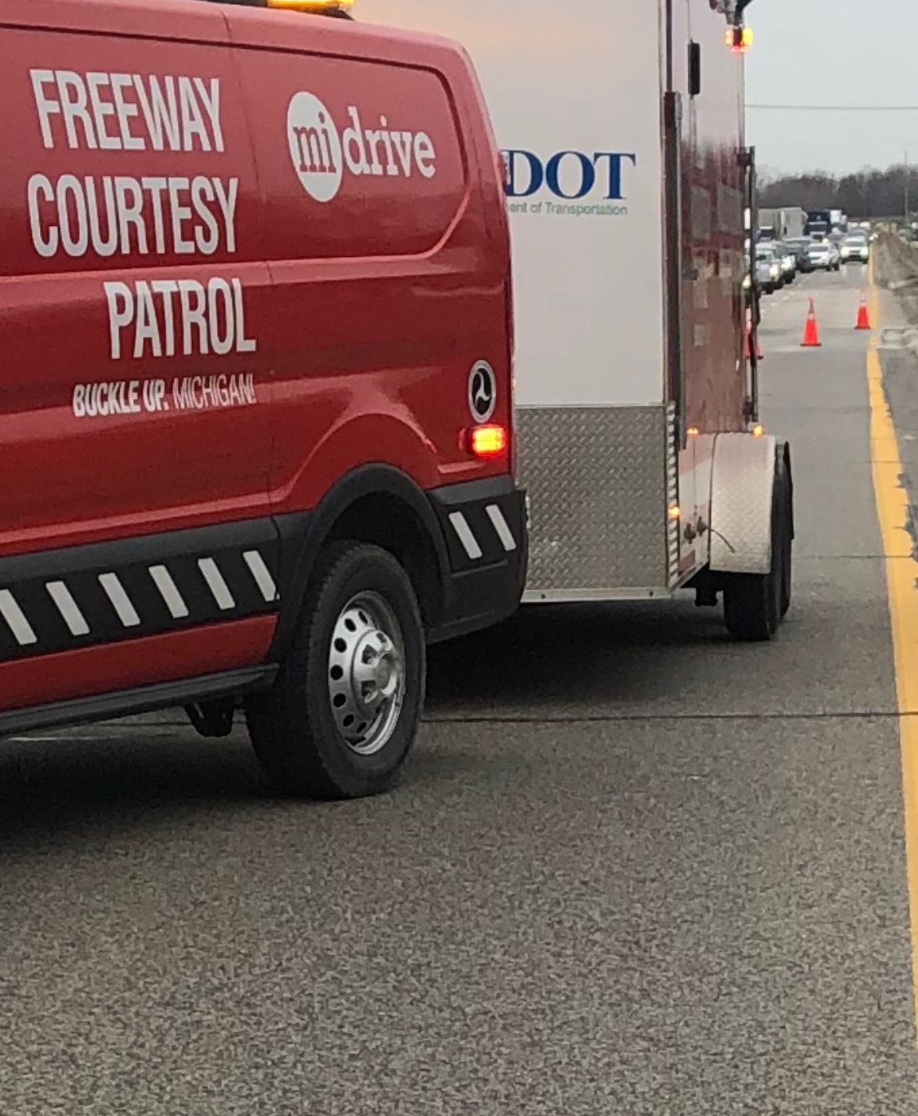
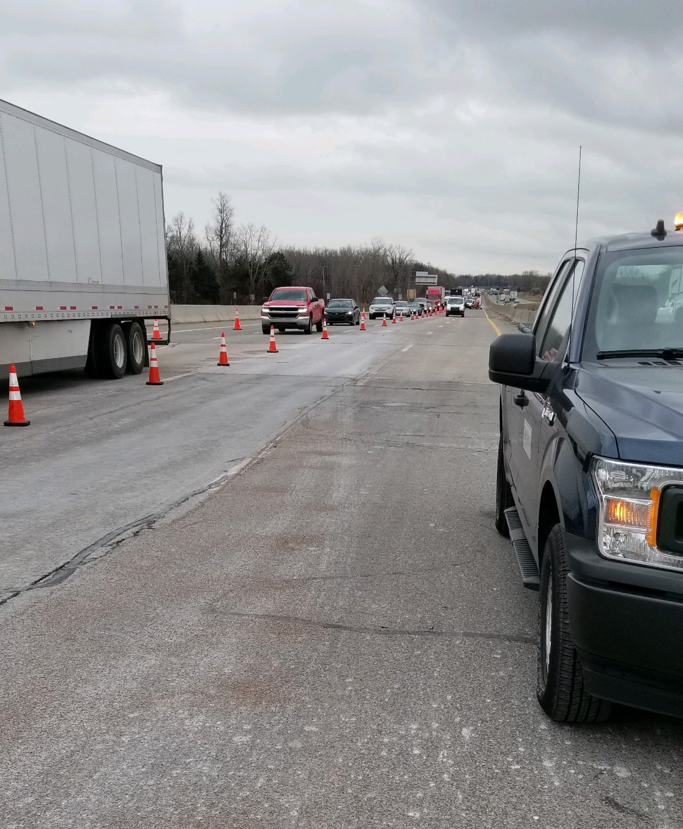
Traffic Control & Clean UP Effort
MDOT FCP Vans
MDOT FCP TIM Trailer
MSP
COMTEC
Byers Towing, Enterprise Environmental Services, LLC
US ecology, Paul Haratyk
Notes: Additional clean up was required on 12/4/2021 11:44 AM – 02:42 PM North River Rd, Joy Rd Overpass and Crocker Rd

Slide 5
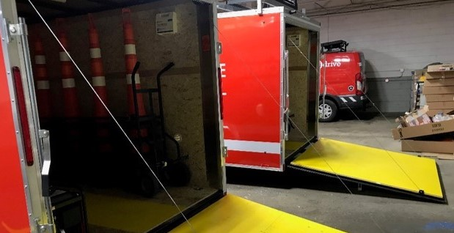
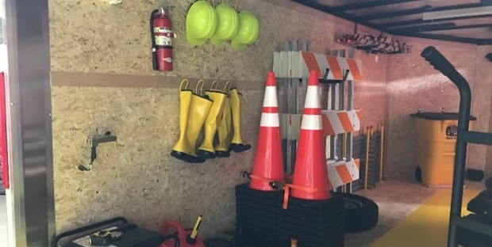
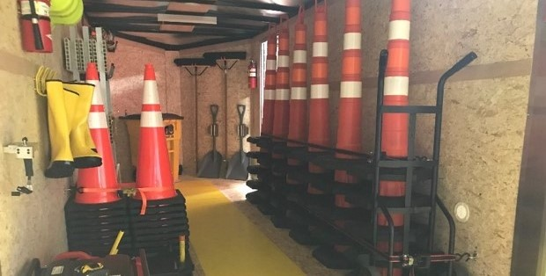
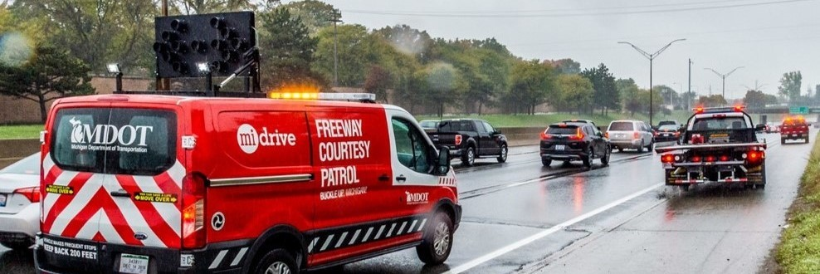
Safety Service Patrols – MDOT Freeway Courtesy Patrol (FCP)
71

Slide 6
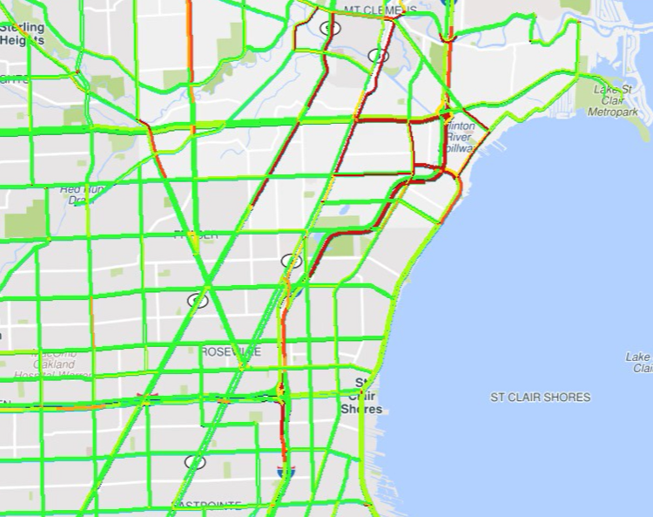
congestion caused by event taken at 5:45 PM

Slide 7
User Delay Cost

Slide 8
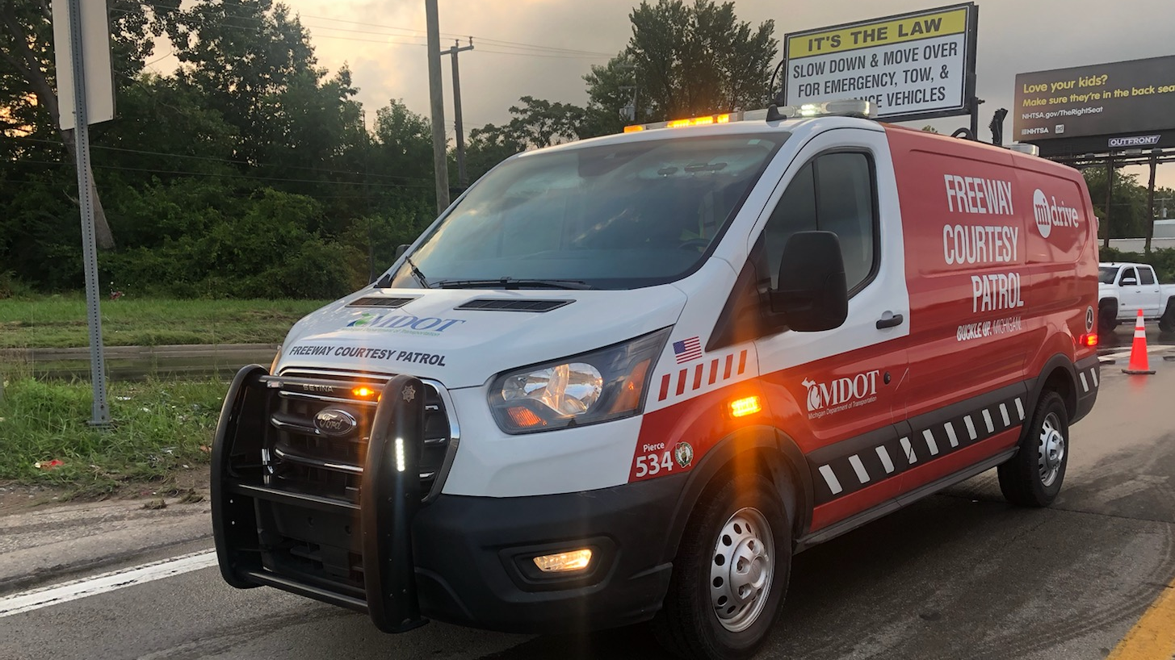
Lessons Learned

Slide 9
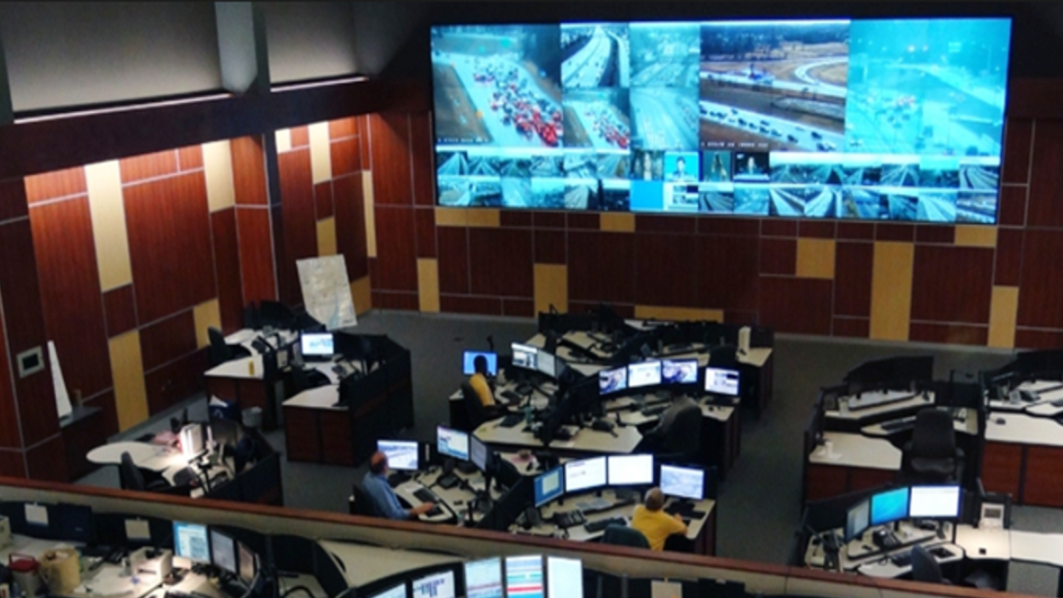
Questions & Answers

