Slide 1
HELP Trucks at the Great New York State Fair
Working Together to Keep the Roads Safe
Hosted
March 10, 2022
Presented by:
Ryan Meagher, P.E.

Slide 2

Overview
Introduction
NYS HELP Truck Program
The Great New York State Fair
HELP Trucks at the Fair
Conclusions
Questions

Slide 3
INTRODUCTION

Slide 4
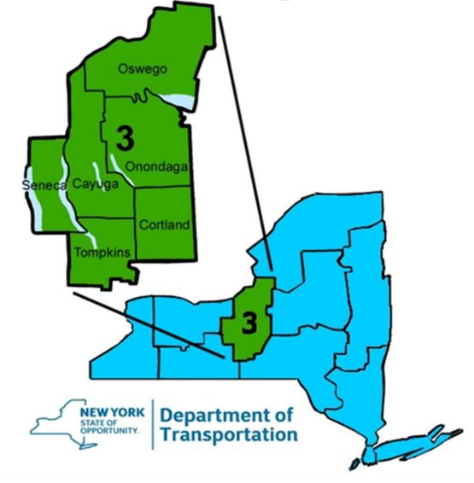
My Background
Hired in June 2005
  Region 3 – Central New York
  Traffic Safety & Mobility
TMC Manager in 2015
HELP Truck Manager in 2017
ITS Manager in 2020

Slide 5
NYS HELP TRUCK
PROGRAM

Slide 6
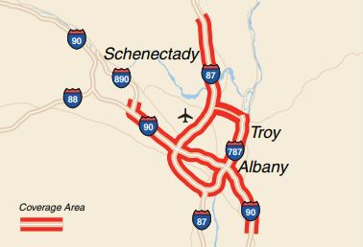
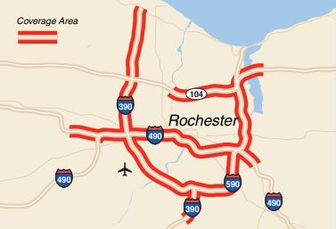
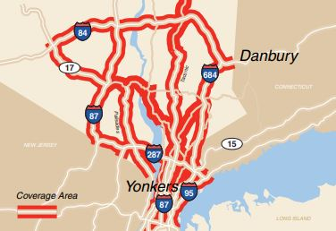
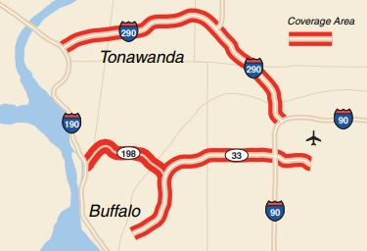
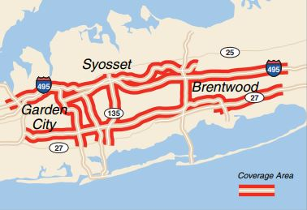
Program Background
Started in Syracuse 12/1/2017
Similar Programs Statewide
Statewide Numbers
  1500 miles patrolled
  27 different beats
  100 plus trucks
Coordination, Dispatching & Monitoring handled by Regional TMCs

Slide 7
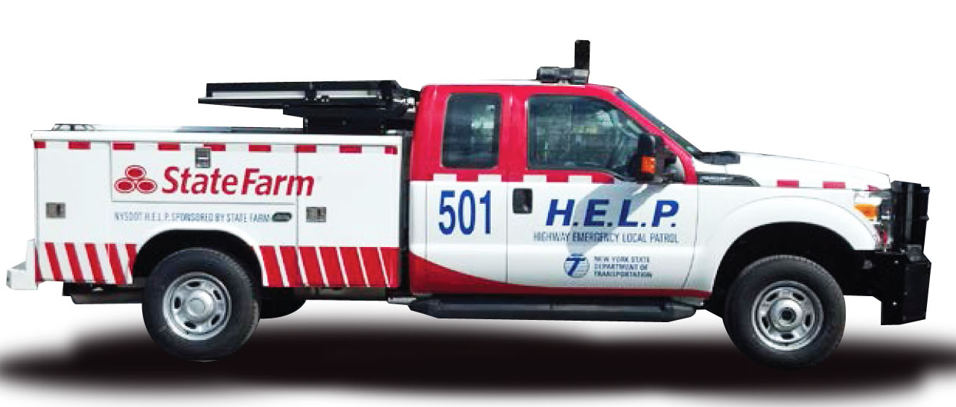
Mission of Program
Facilitate Safe and Efficient Movement
  minimize congestion and improve operation
Incident Management Program
Decrease Delays and Increase Safety
  provide roadside service
  high volume, limited access roadways

Slide 8
HELP Services
FREE to the Public
First Aid and CPR Certified
Incident Detection and Quick Clearance
  minimize effect of motorists
Basic Maintenance Activities
  get out of travel lane
  get up and running again
15 mins or Call Tow Truck
Change Tire
Jump Start Battery
Provide Gas
Provide Directions
Use Cell Phone
Assist Emergency Responders

Slide 9
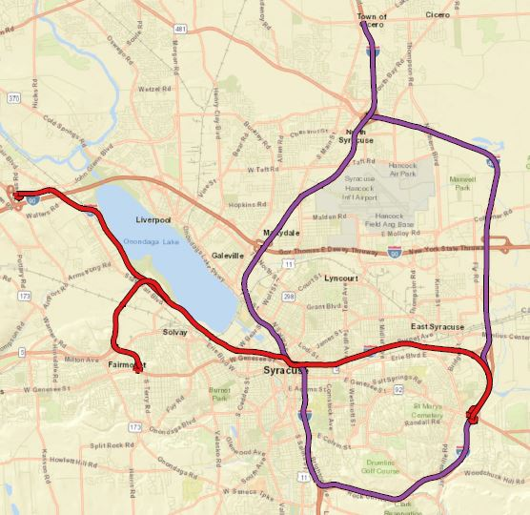
Region 3 HELP Program
Two Truck Patrolling
  70 miles
  Syracuse Area
Focused on Interstates
  I-81, I-481, I-690 and NY-695
Weekday Peak Hours
  6:30 am to 9:30 am
  3:00 pm to 6:00 pm
2000 Assists per Year

Slide 10
THE GREAT NEW YORK STATE FAIR

Slide 11
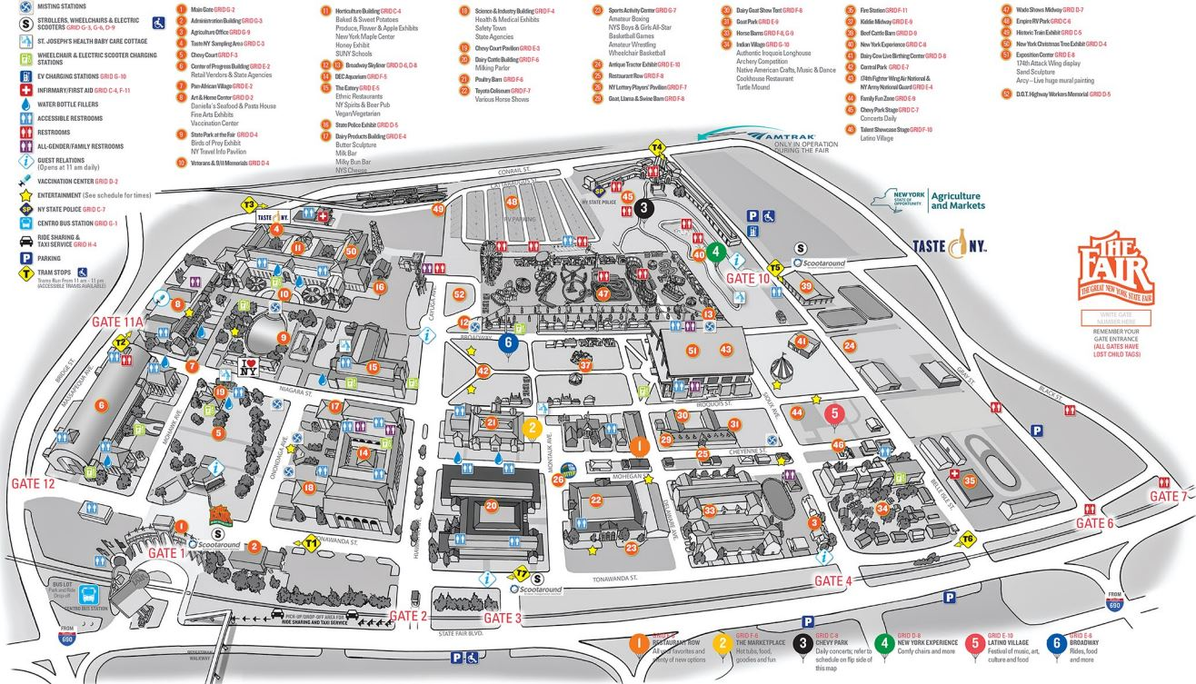
State Fair Overview
Just Outside Syracuse
13 Days Long
375 Acres
400,000 SF of Buildings
New Expo Center
300 Site RV Park
End of August until Labor Day
9:00 am to 11:00 pm
Two Concert Venues Each with Two Concerts a Day

Slide 12
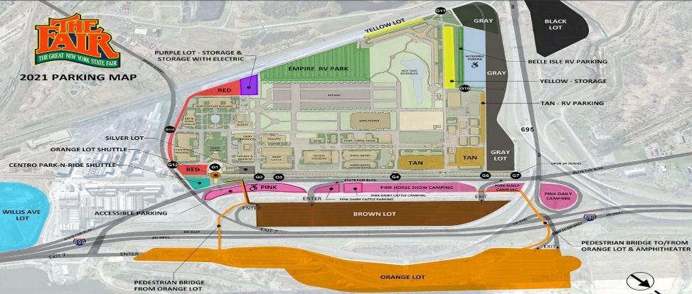
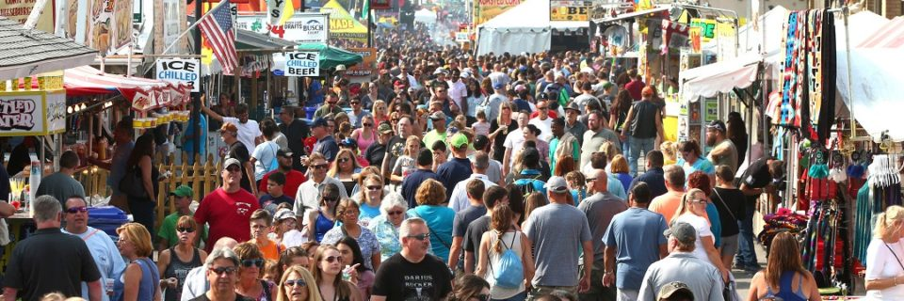
Attendance and Parking
Attendance
Parking
Overall Records in 2016, 2017, 2018 and 2019
  over 1.3 million in 13 days
  over 147,000 for a single day
Attendance Down in 2021
Parking for 23,000 Vehicles
  19,000 on site spots
  4,000 park-n-ride spots

Slide 13
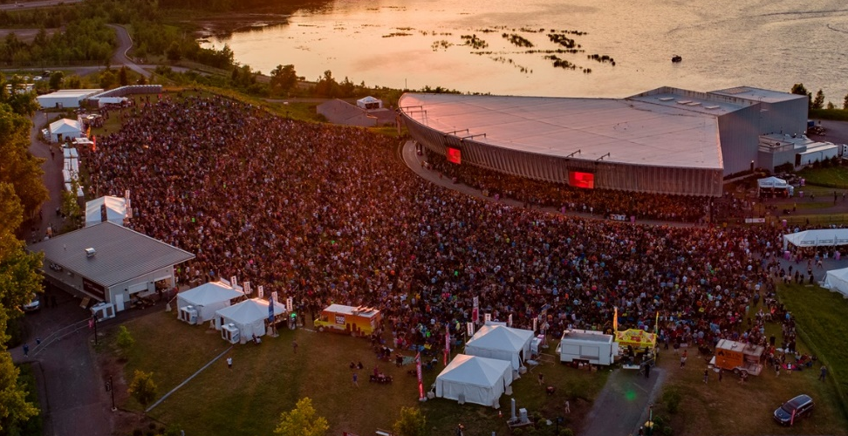
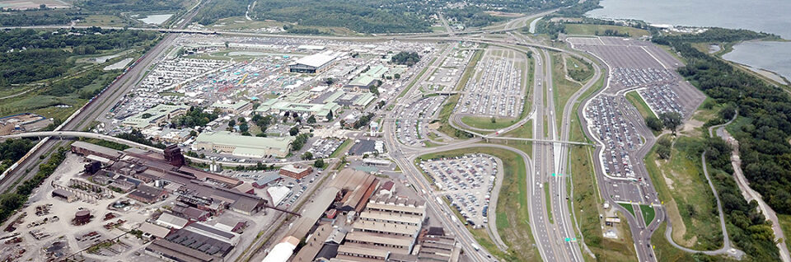
Lakeview Amphitheater
Opened in 2016
  across highway from fairgrounds
About 5 Concerts During Fair
Separate from Fair
Shared Parking Lot
  premier parking
  ADA/shuttle parking

Slide 14
Role of NYSDOT
TMC Works with MCV
MCV Works with Staff on Fairgrounds
  police, parking, signals, drones, HELP and tow trucks
Scenario Based Traffic Management Plan
  message boards, signal timing, HAR messages
Keep Interstate Traffic Flowing
  clear minor incidents to reduce queues and secondary incidents
911 Center
Public
ITS Devices
TMC
NYS Fair
Police
Field Crews
MCV

Slide 15
HELP TRUCKS AT THE STATE FAIR

Slide 16
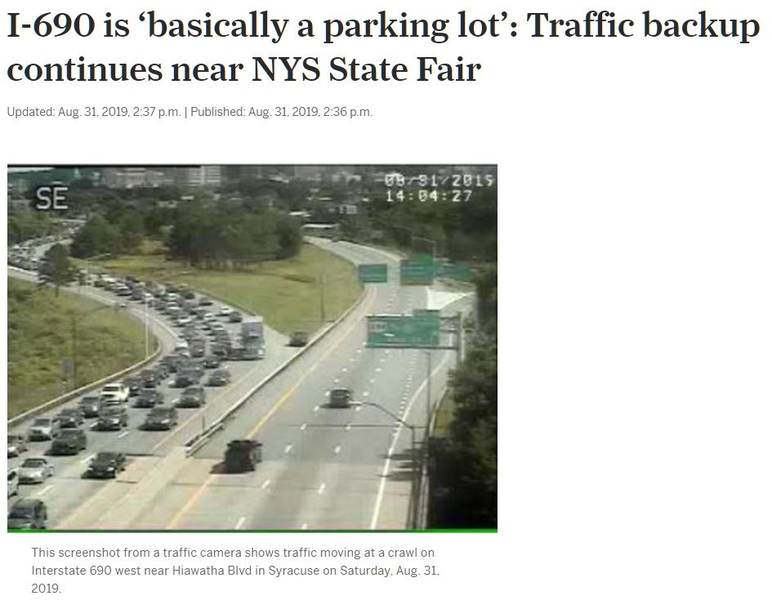
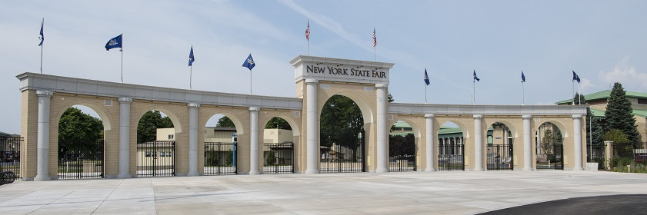
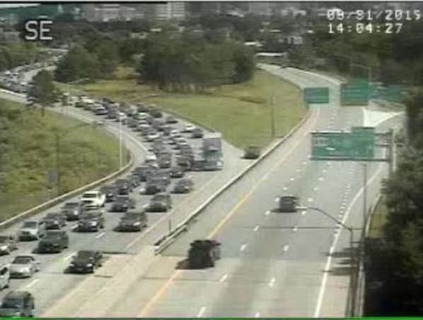
Program Details
Three Trucks During the Fair
  borrowing resources since 2007
Reduce Congestion
  safe and rapid removal of vehicles from road
Dispatched by TMC
  monitored by MCV

Slide 17
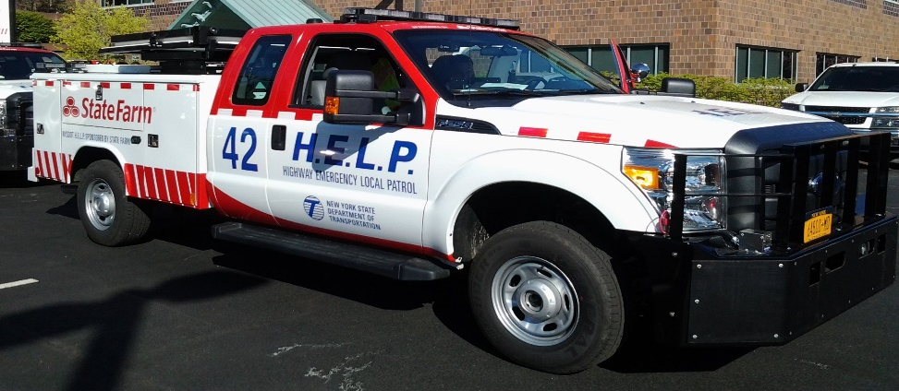
Additional Hours
Weekdays
  two trucks 6:30 am to 22:00 pm
  one truck 12:00 pm to 8:30 pm
Weekends
  two trucks 10:30 am to 11:00 pm
Additional Supervisor
 | Weekday |  | Weekend
 | Non-Fair | During Fair | Non-Fair | During Fair
Drivers | 2 | 5 | 0 | 4
Hours | 12 | 40 | 0 | 24

Slide 18
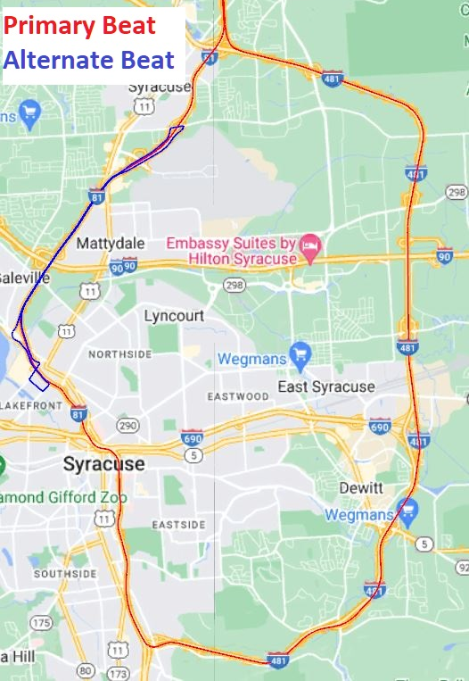
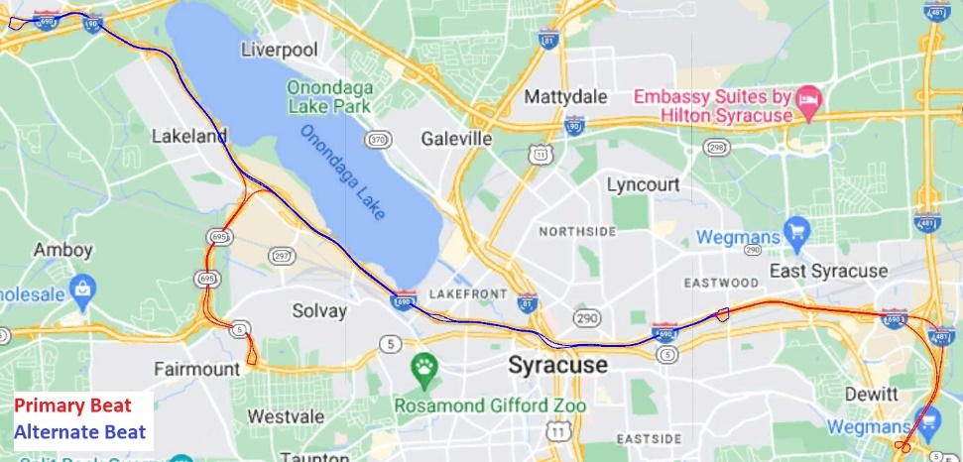
Extended Beats
Primary Beat – Normal Route
Alternate Beat – Focus on Fairgrounds
  alternate beats at busy Fair times
Increase Safety & Decrease Delay near Fair

Slide 19
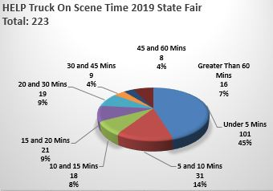
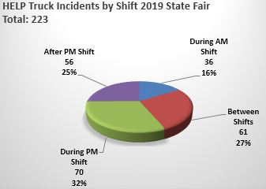
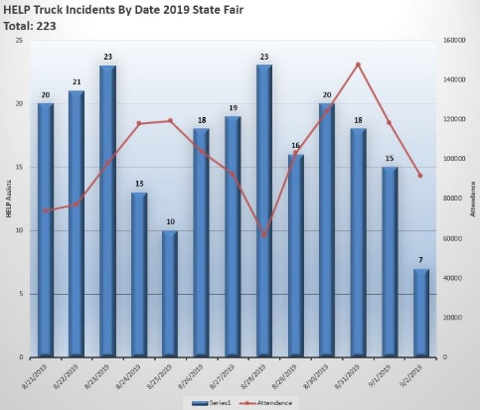
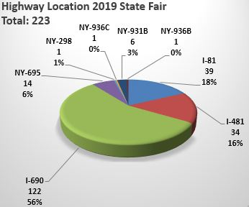
State Fair Statistics
12 Assist per Day during Fair
  7.5 per day during non-Fair
70% for Dispatched Vehicle
Usually Less Than 5 mins on Scene
Majority near Fairground
Evenings are Busiest Time

Slide 20
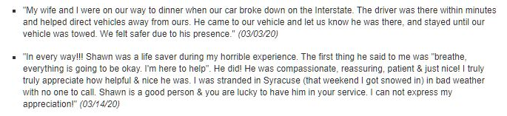
State Fair Feedback
Positive Feedback from All
All the Drivers Work Well Together
Same Drivers Each Year
  from outside region
Similar Procedures Statewide
Good Customer Surveys

Slide 21
CONCLUSIONS

Slide 22
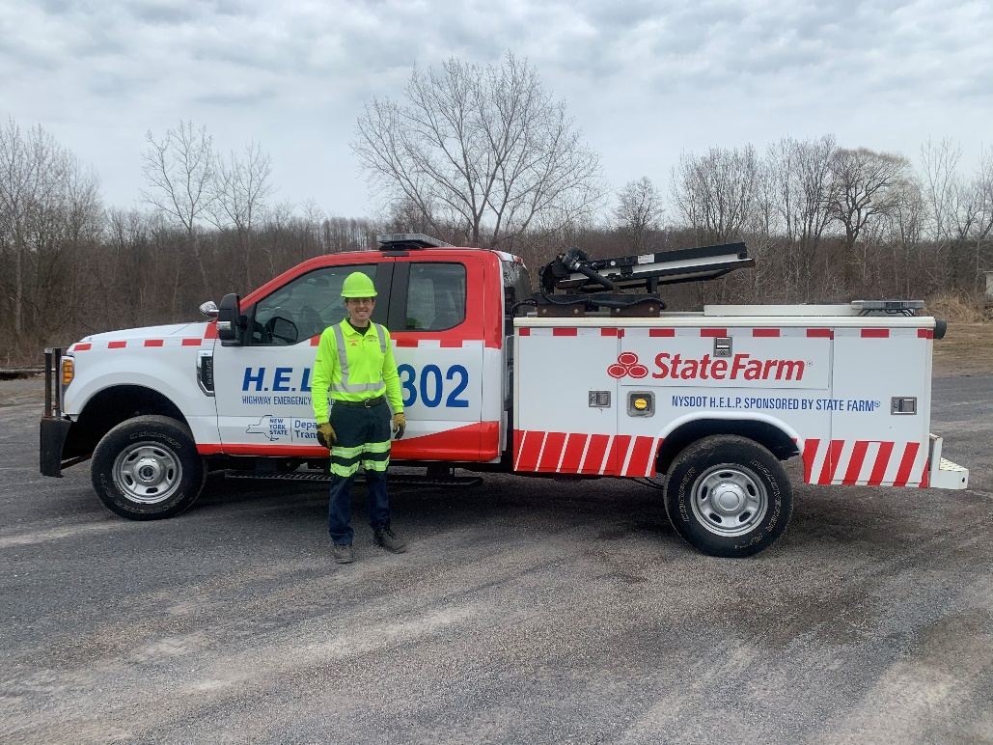
In Closing
HELP Drivers Work Hard Every Day
  make highways safer and less congested
Technology Makes Job Easier
  cameras and drones
Started in 2007 and Always Improving
  no plans to scale back

Slide 23
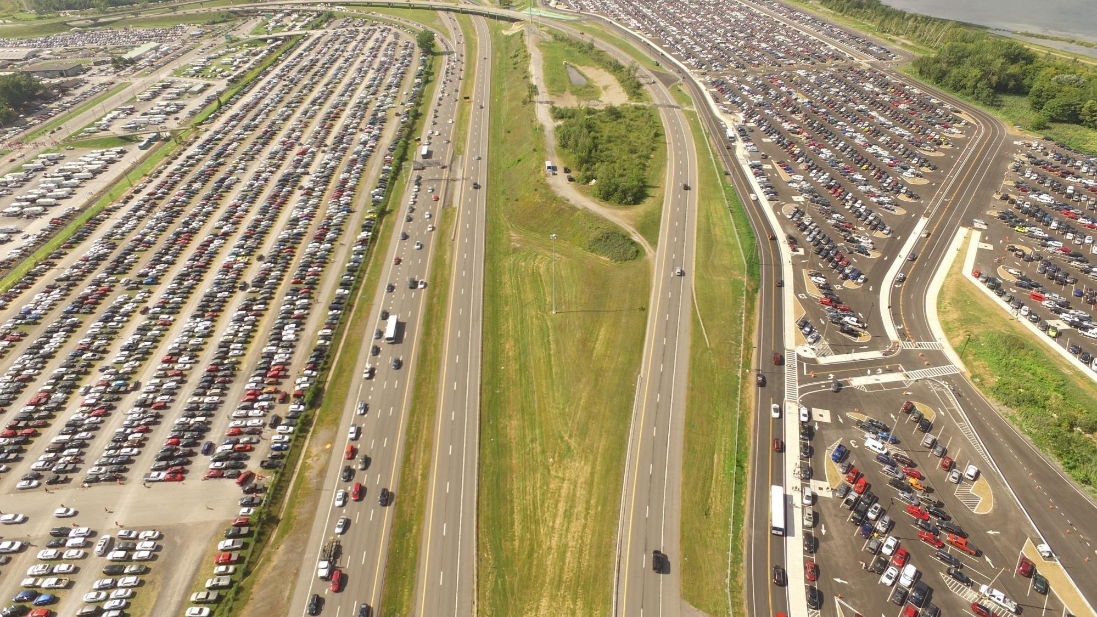
Main Goal
Minimize Congestion and Improve Operation

Slide 24

QUESTIONS

